Slide 1
Lab 06: Geographic Visualization
March 21, 2015
SDS 136
Communicating with Data

Slide 2
Announcements
Excellent work on your VitW presentations! If you made slides for your presentation, please send them to me
Several guests in class today:
Dominique Thiebaut, CS and Charles Staelin, Econ
Ben Miller, MIT Lincoln Laboratory
Notes:
Dominique Thiebaut, CS
Charles Staelin, Economics

Slide 3
Outline
Overview of geographic data
Challenges
Guidelines for making good geoviz
Lab 6: Maps in Tableau

Slide 4
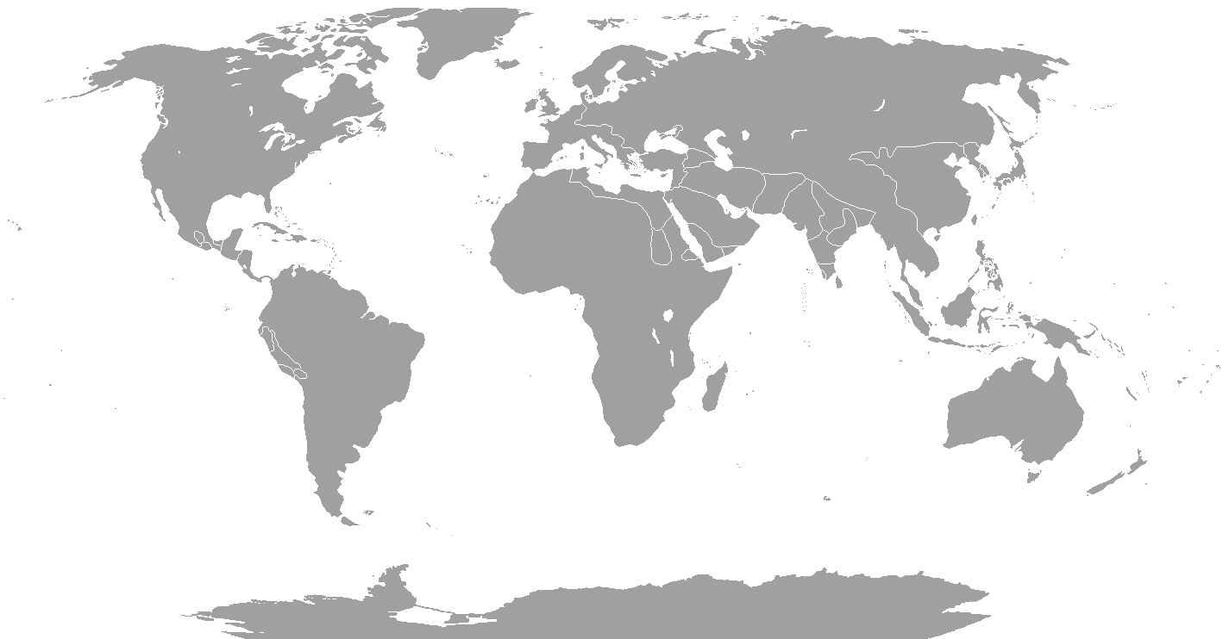
Geographic visualization
Most common: maps
Useful for making geospatial comparisons
Notes:
http://www.nytimes.com/interactive/2015/10/31/upshot/who-still-doesnt-have-health-insurance-obamacare.html

Slide 5
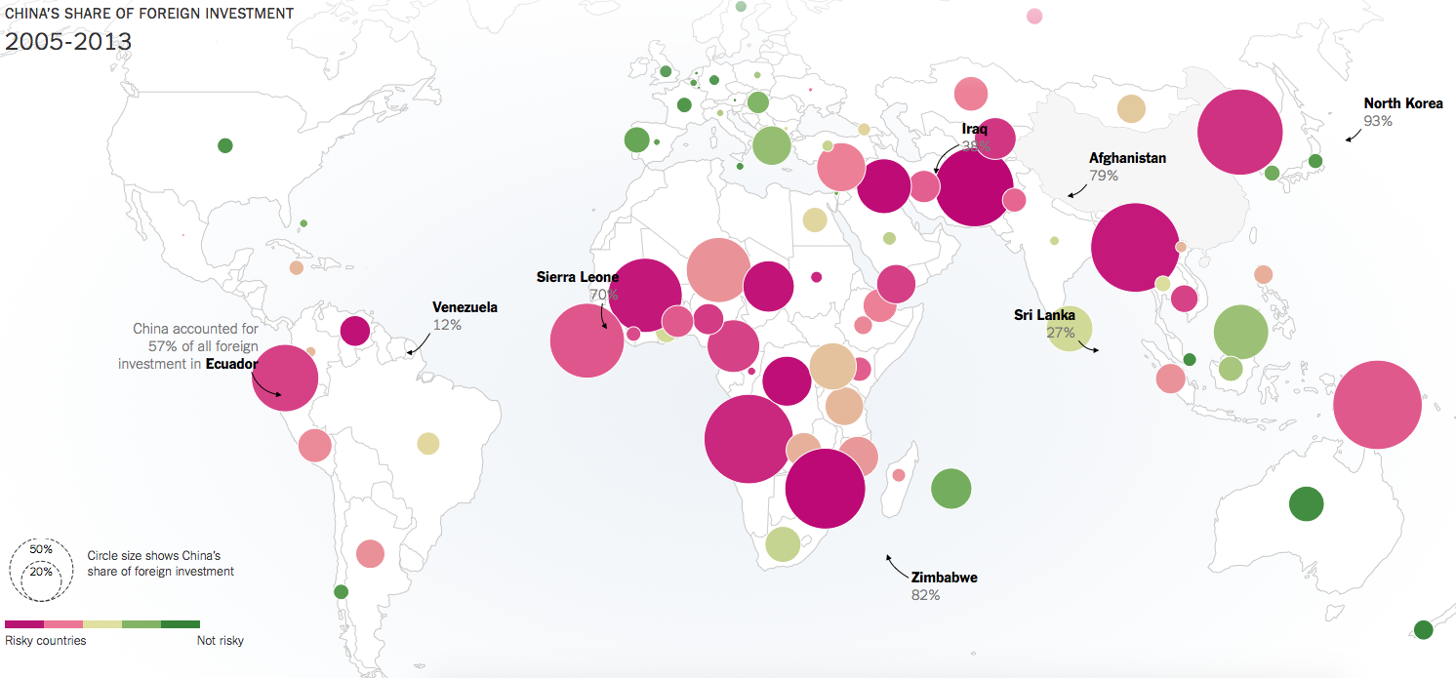
Geographic visualization: points
Notes:
http://www.nytimes.com/interactive/2015/07/24/business/international/the-world-according-to-china-investment-maps.html
Thanks, Zoey!

Slide 6
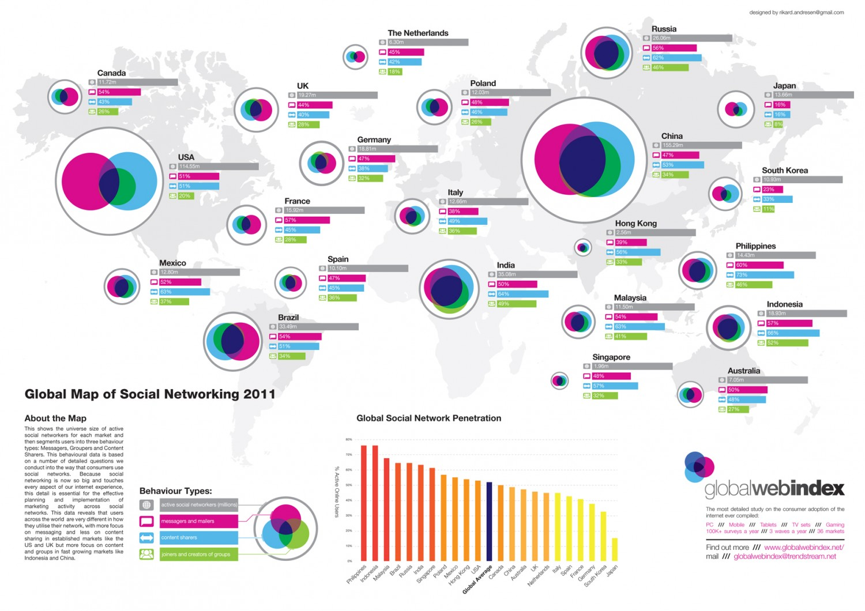
Geographic visualization: glyphs
Notes:
http://www.nytimes.com/interactive/2015/10/31/upshot/who-still-doesnt-have-health-insurance-obamacare.html

Slide 7
Geographic visualization: over time
Notes:
http://visual.ly/macrometeorites
Thanks, Abigail!

Slide 8
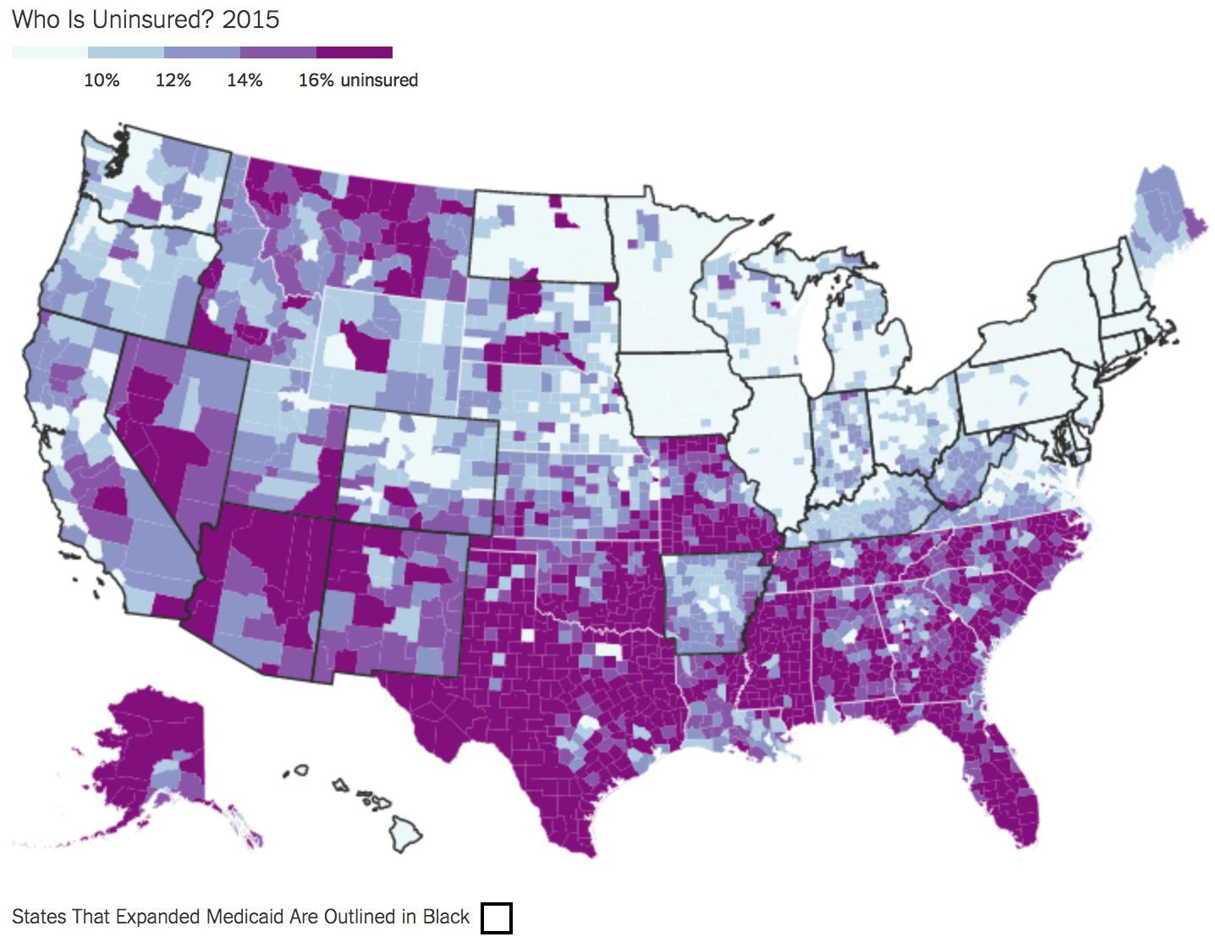
Geographic visualization: filled regions
Notes:
http://www.nytimes.com/interactive/2015/10/31/upshot/who-still-doesnt-have-health-insurance-obamacare.html

Slide 9
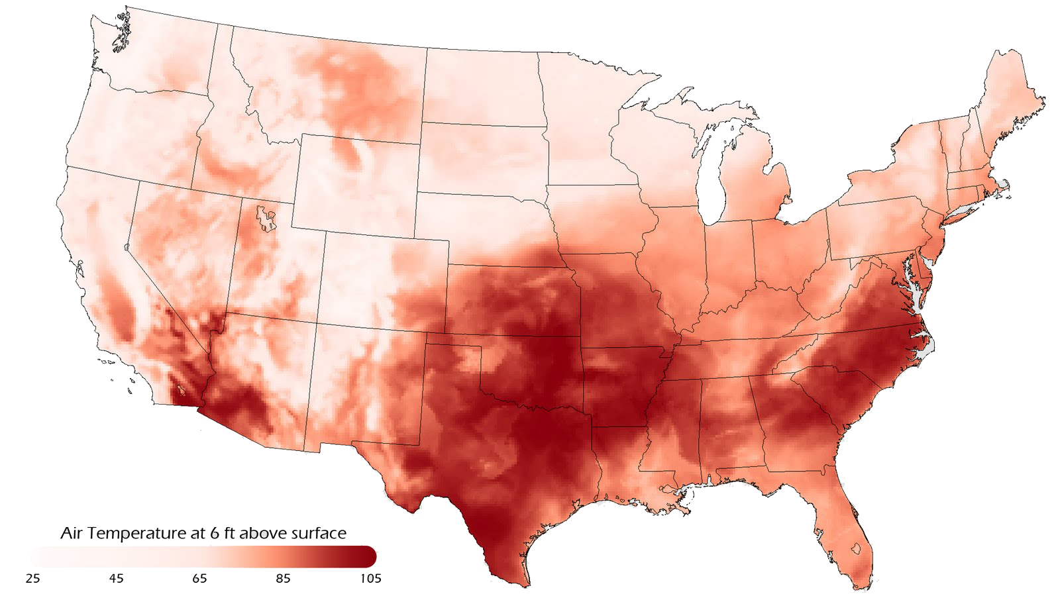
Geographic visualization: heatmaps
Notes:
http://www.visualnews.com/2015/07/02/data-visualization-101-heatmaps/

Slide 10
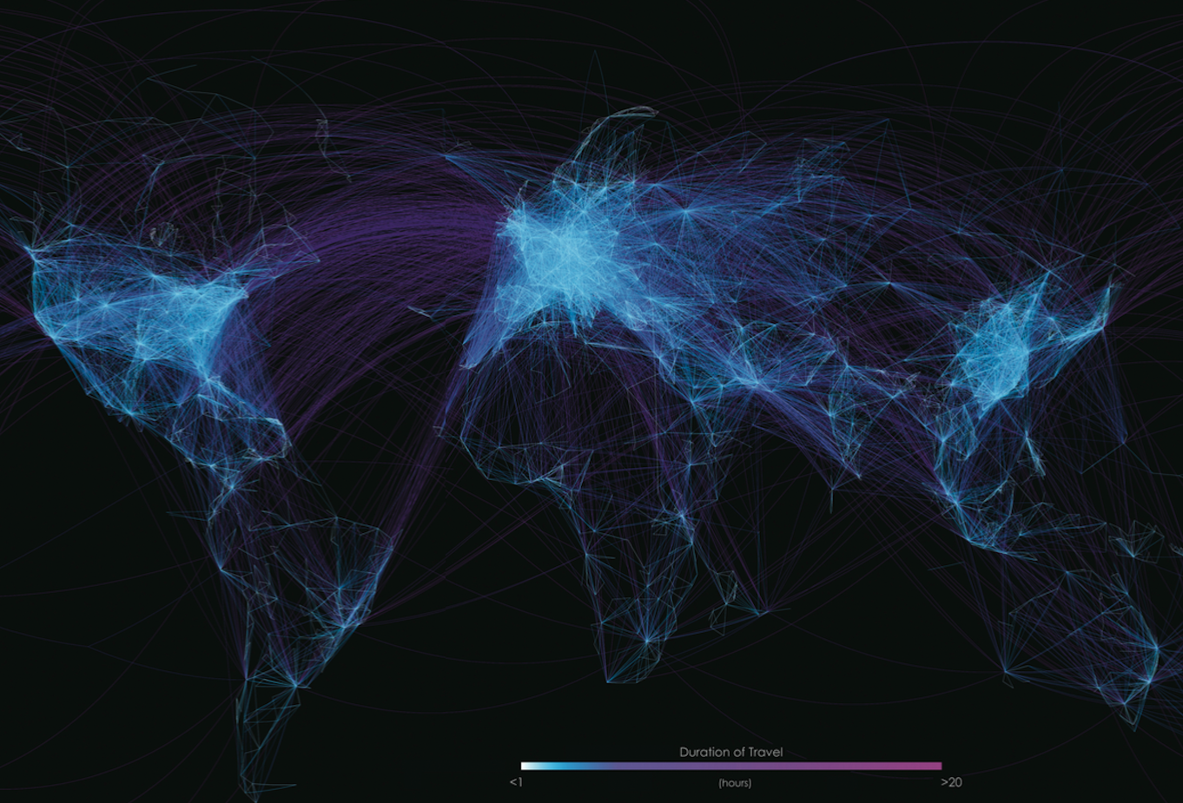
Geographic visualization: connections
Notes:
http://front.dadaviz.com/media/viz_images/global-flight-network-1420035245.85-1666817.png

Slide 11
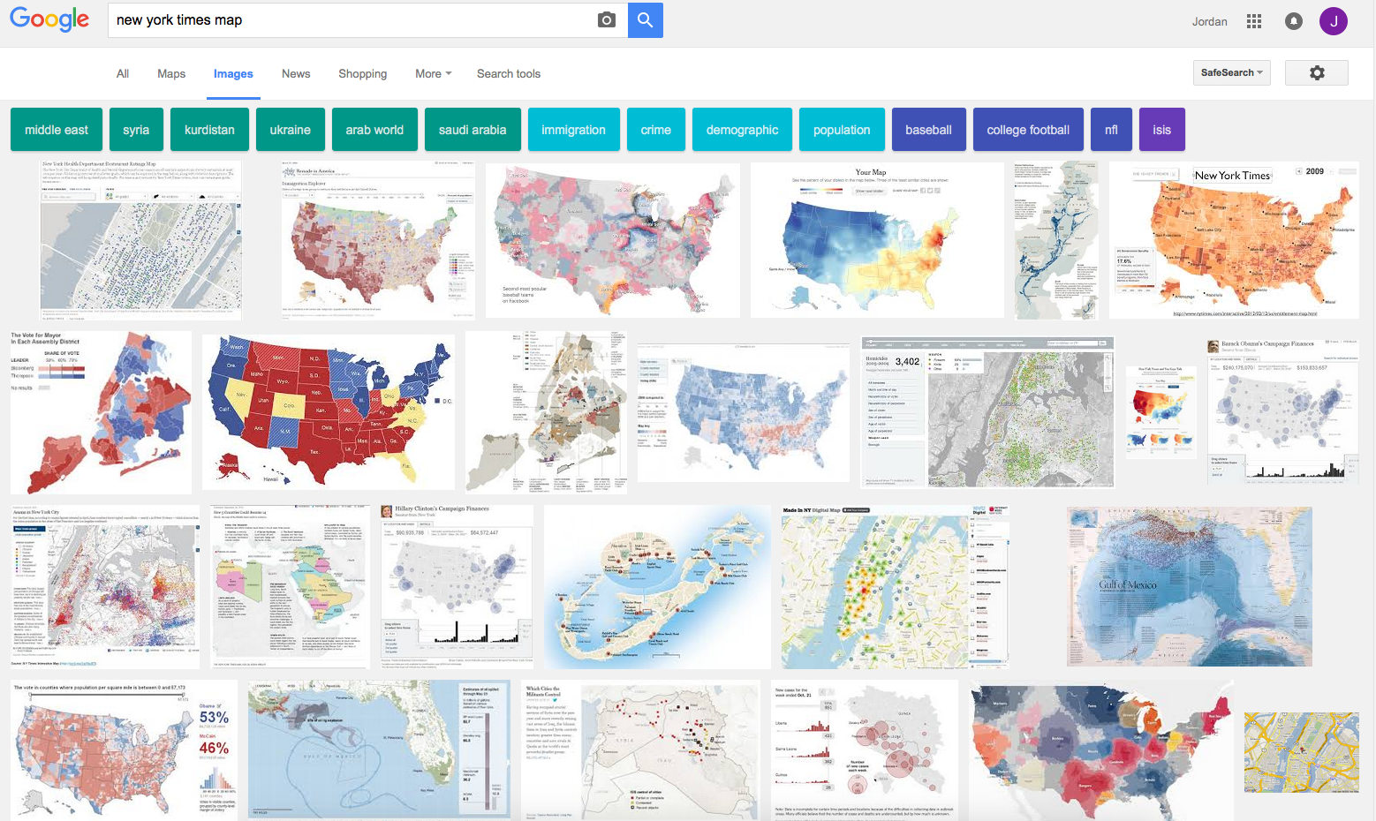
Examples: NYT maps

Slide 12
Discussion
Question:
What makes geographic visualizations
so compelling?

Slide 13
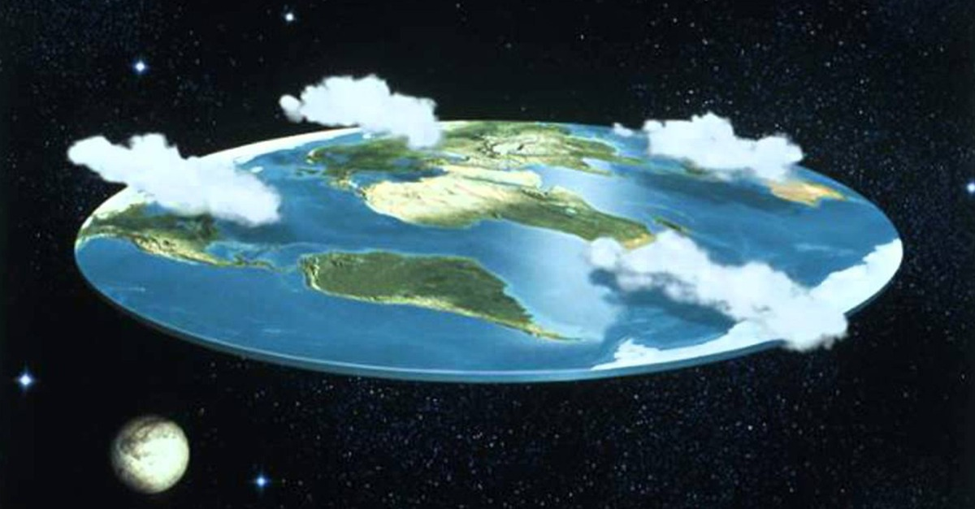
Challenge 1: flat earth?

Slide 14
Activity: spherical grumpy cat (5-7 min)

Slide 15
Impact of map projections
Campbell, J.E., & Shin, M. (2012). Geographic Information System Basics.
Deetz, C. H., & Adams, O. S. (1921). Elements of map projection with applications to map and chart construction.

Slide 16
Challenge 2: granularity mismatch
Image courtesy of politicalmaps.org
Notes:
http://politicalmaps.org/2012-electoral-map/

Slide 17
Example: 2012 Presidential Election
Image courtesy of politicalmaps.org
Notes:
This data was collected by county
Question: how do we elect a president in the US?

Slide 18
Example: 2012 Presidential Election
Image courtesy of politicalmaps.org

Slide 19
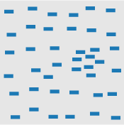
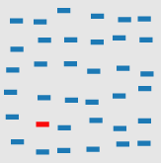
Challenge 3: perceptual trickery
Flashback to when we talked about perception
What preattentive features are at work in these maps?
clustering (proximity)
color (hue)
size

Slide 20
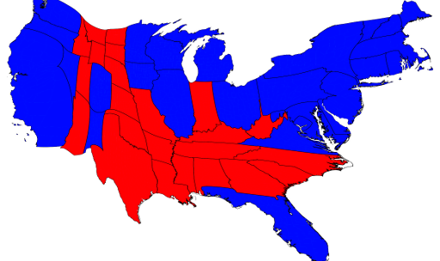
Example: 2012 Presidential Election
Image courtesy of http://politicalmaps.org

Slide 21
Example: 2012 Presidential Election
OBAMA 332
ROMNEY 206
270 votes
needed to win
Number of Electoral Votes Captured

Slide 22
Challenge 4: non-adjacent comparison
Are Maine and
S. California
voting similarly?
Image courtesy of http://politicalmaps.org

Slide 23
Challenge 5: missing data
Image courtesy of http://politicalmaps.org

Slide 24
Challenge 6: occlusion
What’s going on in
Turkmenistan and
Uzbekistan?
Notes:
http://www.nytimes.com/interactive/2015/07/24/business/international/the-world-according-to-china-investment-maps.html
Thanks, Zoey!

Slide 25
Discussion: (rough) guidelines for maps
Question:
What do we need to keep in mind
to make good geographic visualizations?

Slide 26
Lab 6: building maps in Tableau
Instructions for today’s lab are available at:
http://www.science.smith.edu/~jcrouser/SDS136/labs/lab6
We’ll be working with data on global rates of Tuberculosis from the World Health Organization
Don’t worry if you don’t know anything about epidemiology (the study of disease) - just ask for help if you get stuck ☺
To get credit for this lab, post your map to Piazza along with a brief description of what you found

Slide 27
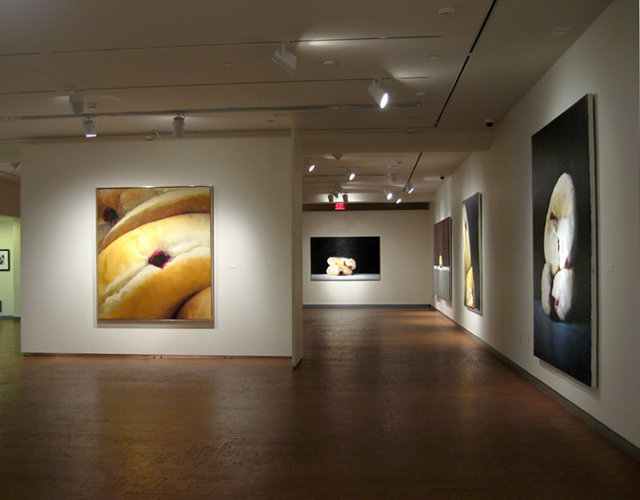
Up next
During Wednesday’s class we have a special session at the Smith College Museum of Art
Don’t need laptops, but you may want a notebook
We’ll meet in the museum lobby at 2:40 sharp!

