Slide 1
Lab 05: Coordinated Multiple Views
March 2, 2015
SDS 136
Communicating with Data

Slide 2
Announcements
Labs: please turn them in before spring break!
Looking for a campus job?
Smith IR is looking for their next RA
Looking specifically for someone early in their Smith career (opportunity for a multi-year position)

Slide 3
Outline
Multiple views
Coordination example: brushing and linking
Walkthrough: using Actions in Tableau
Lab 5: Coordinated Multiple Views

Slide 4
Multiple views
Different
representations
Different
data
Systems that use two or more distinct views
to support the exploration of a single concept or domain

Slide 5
When to use multiple views?
The data is too big
Lots of attributes
Lots of observations
The data is too complicated
Lots of data sources
Lots of data types
The data has several interesting parts, but no one visualization highlights them all

Slide 6
Need to think about: resource optimization

Slide 7
Need to think about: resource optimization

Slide 8
Guidelines for multiple views
Balance the costs of presenting multiple views with the benefits of using the views
Split complex data into multiple views to create manageable chunks
Use views that are complimentary, bringing out correlations and/or disparities
Use perceptual cues to:
make relationships more apparent to the reader
focus the reader’s attention on the right view at the right time

Slide 9
Coordination: brushing and linking
Big idea: actions in the real world have ripple effects; actions on a visualization should too
Brushing: the visualization responds (usually through highlighting) as a person “brushes past” data points
Linking: the visualization connects related data points across multiple views

Slide 10
Coordination: brushing and linking

Slide 11
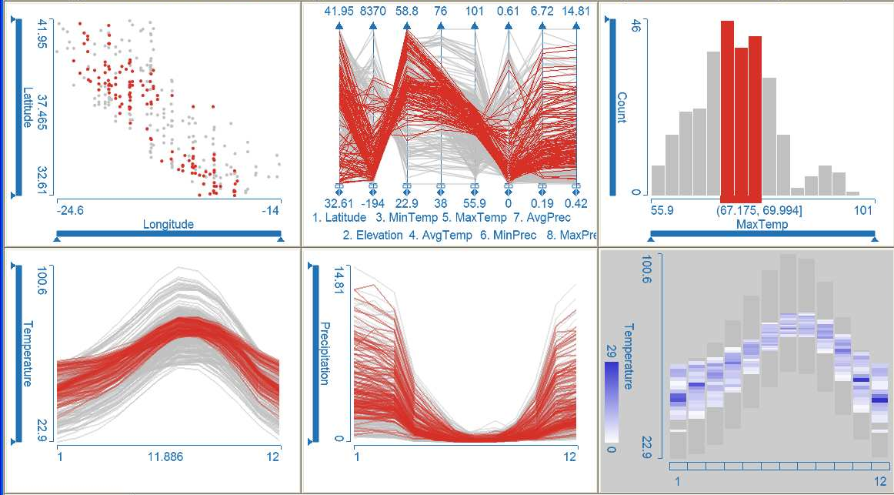
Coordinated multiple views
Multiple views + brushing and linking
Big idea: propagate interaction from one view to all others, respond as appropriate

Slide 12
Discussion
What would we need to make this work?

Slide 13
Walkthrough: working with actions

Slide 14
Lab 5: coordinated multiple views
Instructions for today’s lab are available at:
http://www.science.smith.edu/~jcrouser/SDS136/labs/lab5
This is the first of several open-ended labs, where you get to decide what to visualize and how
It’s okay if you get stuck! Just ask for help ☺
To get credit for this lab, publish your visualization to Tableau Public and post a link to Piazza

Slide 15
Up next
Next week: “Visualization in the Wild”
Please post your topic by Friday
Remember to pick a time to present
3 Monday slots left
3 Wednesday slots left

