Slide 1
Lab 04: Visualizing Multiple Variables
February 24, 2015
SDS 136
Communicating with Data

Slide 2
Outline
Recap: visualizing correlation
What about multidimensional data?
Scatterplot matrix (SPLOM)
Parallel coordinates
Lab 3: SPLOMs and parallel coordinates in Tableau

Slide 3
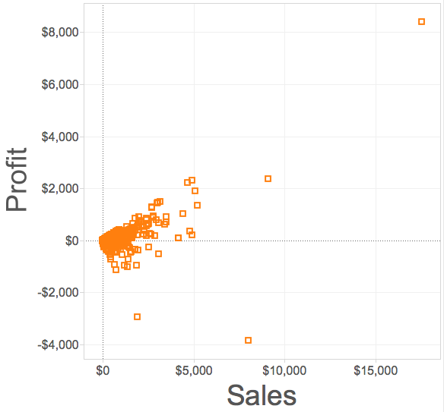
Recap: scatterplot
Goal: show the correlation between two quantitative (numerical) variables
Maximum value(s) in each dimension
General trend
Outliers (points that are “far from the pack”)
Minimum value(s) in each dimension

Slide 4
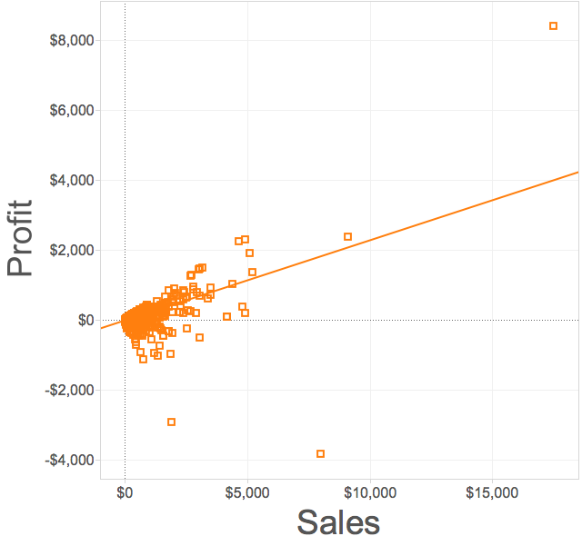
Recap: positive correlation
Two variables moving in the same direction
Trend line points up and to the right

Slide 5
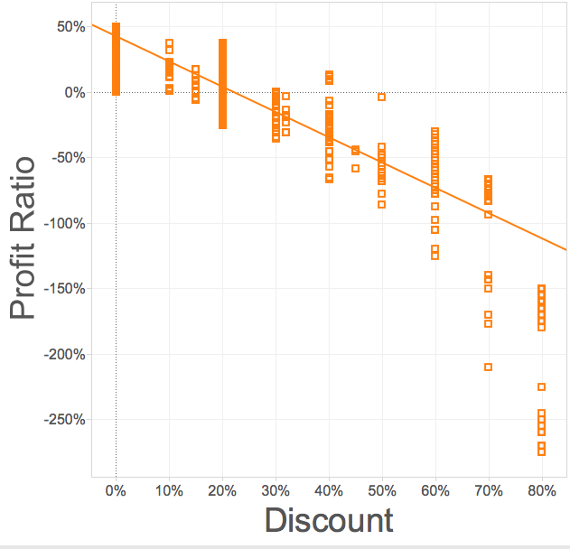
Recap: negative correlation
Two variables moving in opposite directions
Trend line points down and to the right

Slide 6
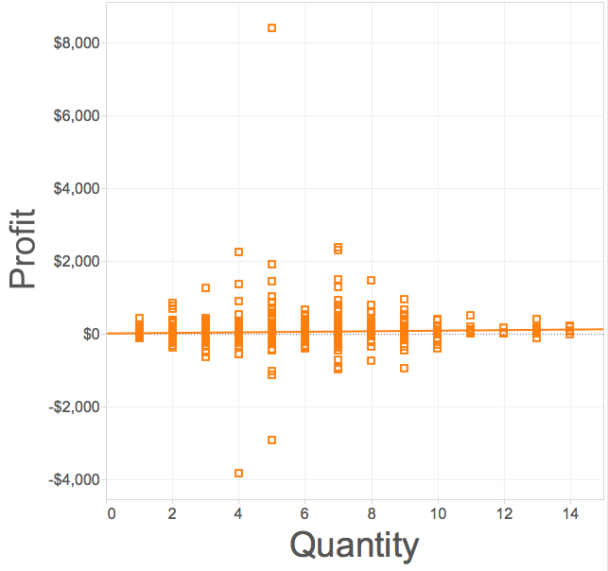
Recap: no correlation
Two variables are independent of one another
No discernable pattern
Trend line is flat

Slide 7
Discussion
Scatterplots show us the relationship between just two variables at a time
Question: how could we use this same idea to get a sense for an entire dataset?
Answer: multiple scatterplots!

Slide 8
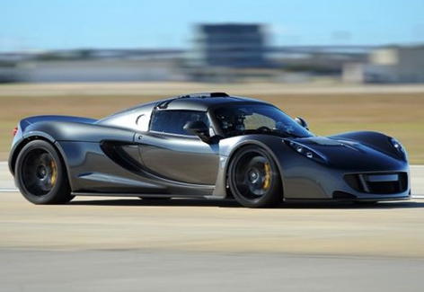
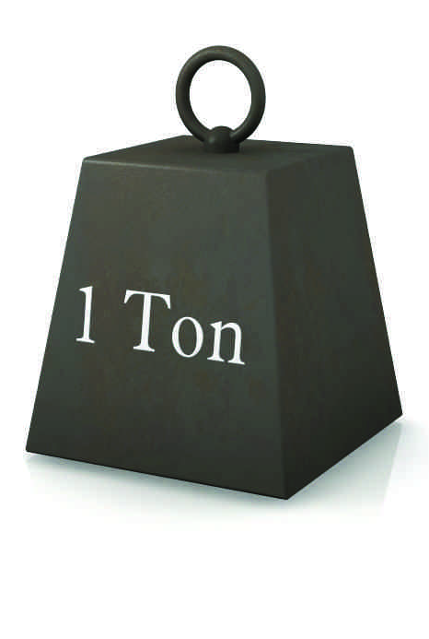
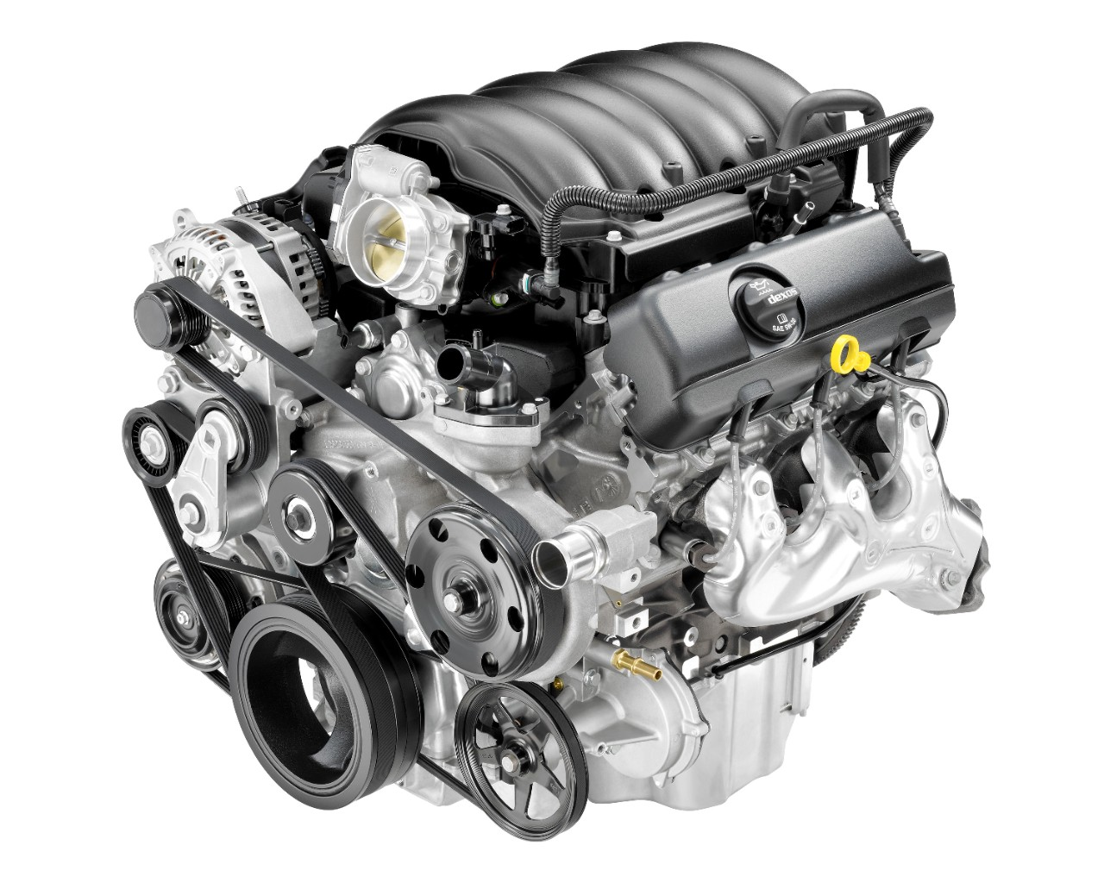
Example: Auto data
acceleration
horsepower
weight

Slide 9
Scatterplot matrix (SPLOM)

Slide 10
Scatterplot matrix (SPLOM)

Slide 11
Discussion: pros and cons
What’s good about SPLOMs?
What’s not so good?
What other visualizations have we seen that show correlation (i.e. “changing together”)?

Slide 12
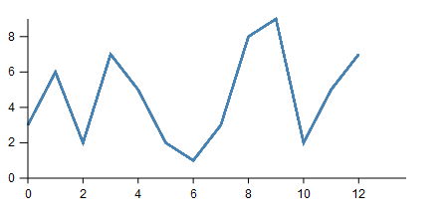
Recap: line charts
Definition: a visualization that uses lines to show relative changes in two continuous variables
Vertical axis shows the dependent variable
Horizontal axis shows the independent variable

Slide 13
Variations: multiple independent lines

Slide 14
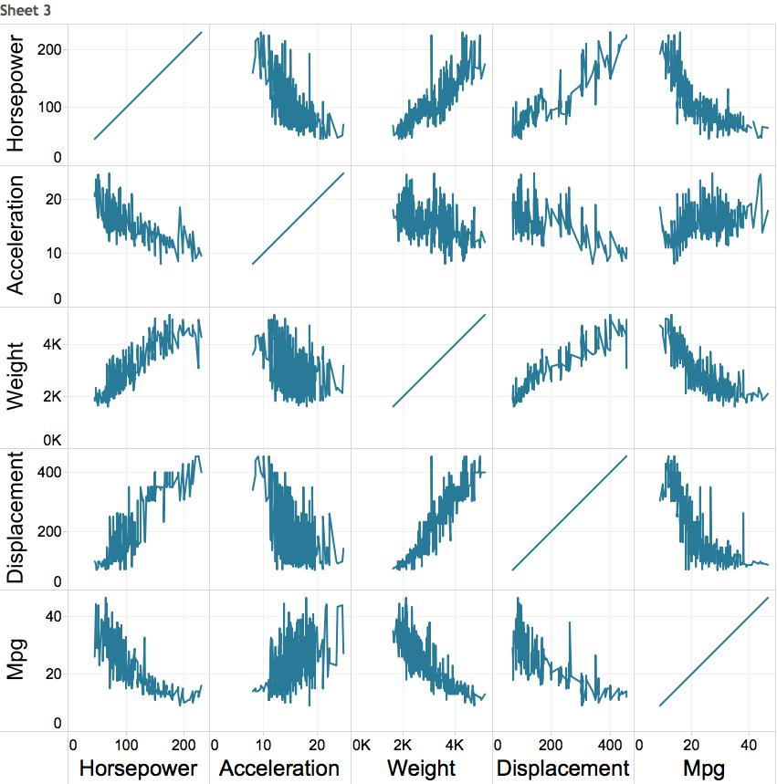
First idea: line chart matrix?

Slide 15
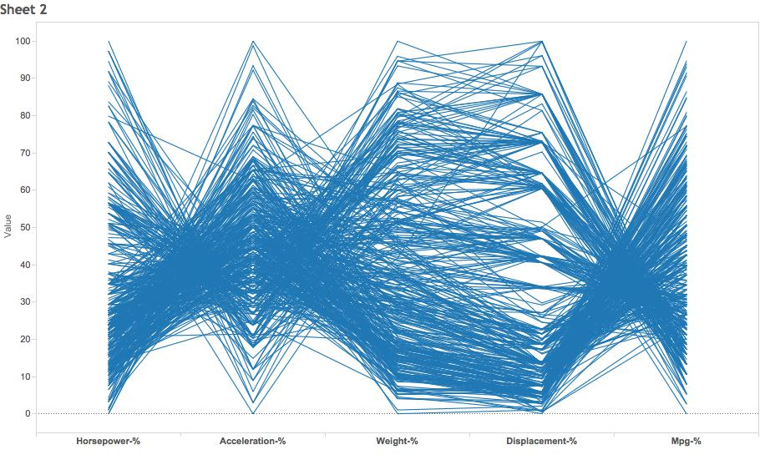
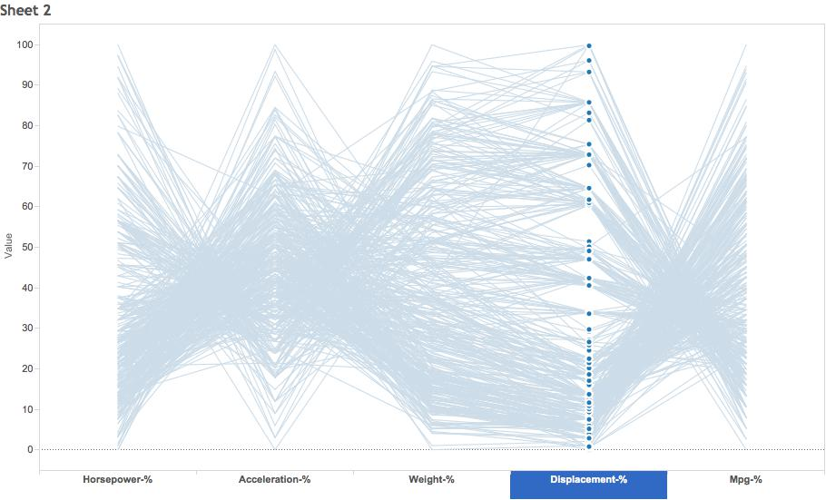
Weirder idea
H A W D M
“parallel coordinates plot”

Slide 16
Discussion: parallel coordinates
What patterns do you see?
Is anything pre-attentive?
Any potential problems?
H A W D M

Slide 17
Lab 4: SPLOMs and Parallel Coordinates
Instructions for today’s lab are available at:
www.science.smith.edu/~jcrouser/SDS136/labs/lab4
You’ll find several do-it-yourself pieces scattered throughout the lab, along with some questions
It’s okay if you get stuck! Just ask for help ☺
To get credit for this lab, post responses to Piazza

Slide 18
Up next
A3 due Monday by 11:59pm
Next week: interactive visualization

