Slide 1
Lab 03: Scatterplots
February 10, 2015
SDS 136
Communicating with Data

Slide 2
Outline
Scatterplots
Definitions
Comparing multiple categories
What gets encoded?
Pros and cons
Questions to ask
Things to watch out for
Lab 3: Building scatterplots in Tableau

Slide 3
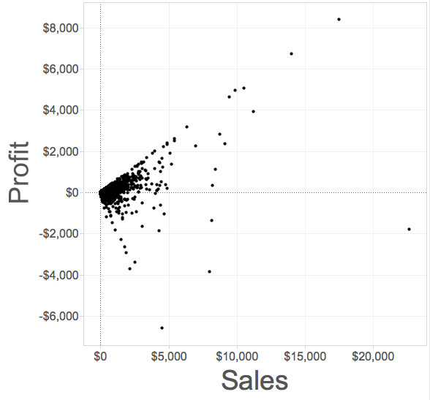
Scatterplot
Definition: a visualization that shows the correlation between two quantitative (numerical) variables
Each point represents an observation
One axis shows one quantitative measure
The other axis shows a second quantitative measure

Slide 4
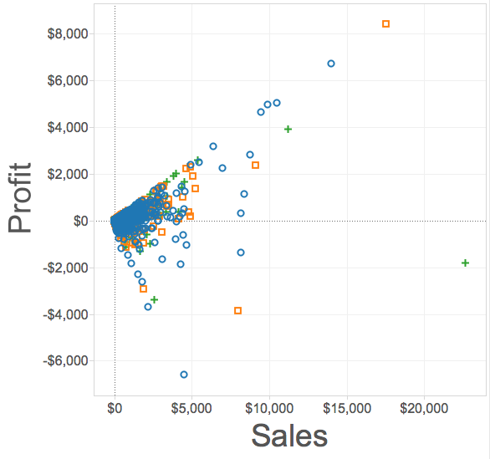
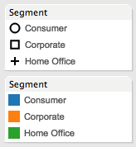
Scatterplots on multiple categories
We can change the mark type to compare the same variables across different categories

Slide 5
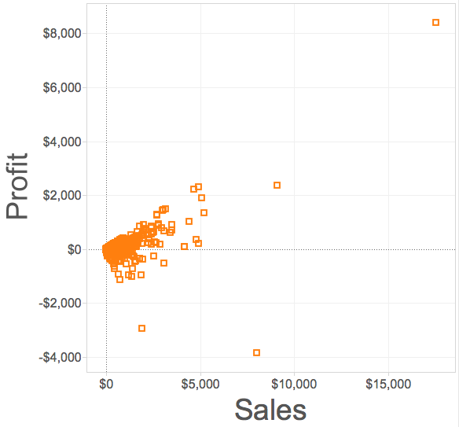
Correlation
Scatterplots are particularly useful for highlighting correlation (what’s that?)
Trend line (a.k.a “line of best fit”)

Slide 6
Trend lines
May pass through all, some, or none of the data points
Useful for making predictions
Trend line (a.k.a “line of best fit”)

Slide 7
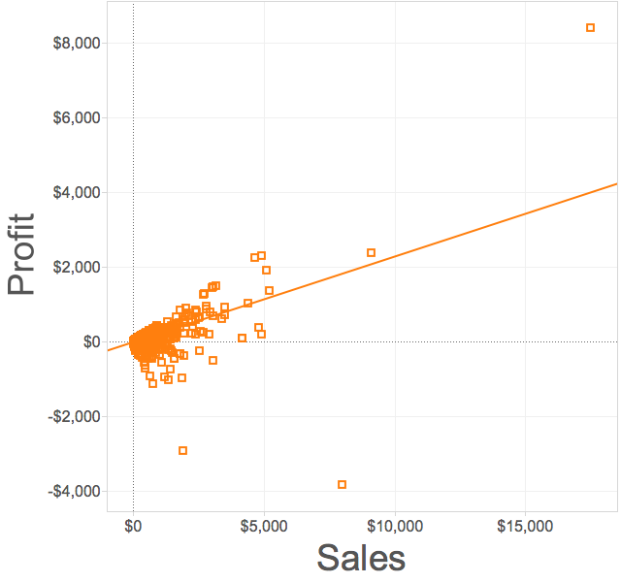
Positive correlation
Two variables moving in the same direction
Trend line points up and to the right

Slide 8
Positive correlation: example

Slide 9
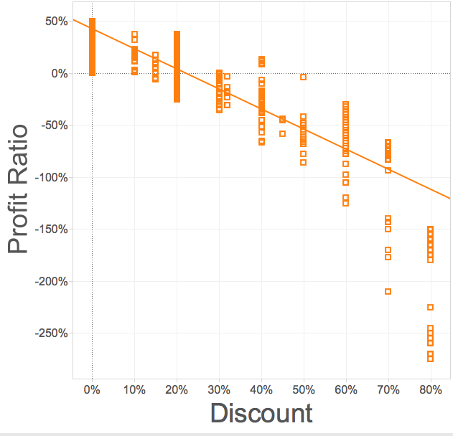
Negative correlation
Two variables moving in opposite directions
Trend line points down and to the right

Slide 10
Negative correlation: example

Slide 11
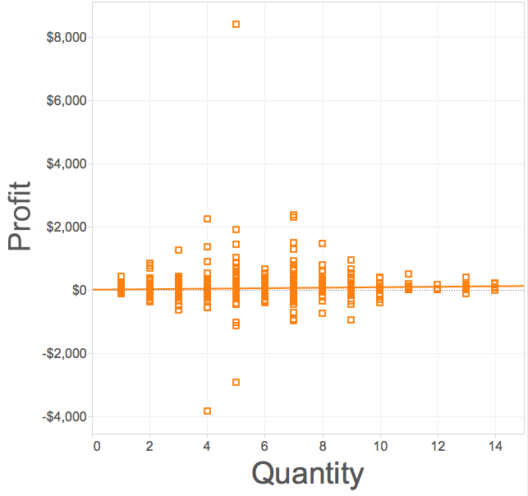
No correlation
Two variables are independent of one another
No discernable pattern
Trend line is flat

Slide 12
No correlation: example

Slide 13
What gets encoded
Maximum value(s) in each dimension
General trend
(what law is at work here?)
Outliers (points that are “far from the pack”)
Minimum value(s) in each dimension

Slide 14
Pros and cons
What’s good about scatterplots?
What’s not so good?

Slide 15
Questions to ask
How many categories?
Examine the data to figure out how many different categories you want to show
Use this to determine your symbols (don’t forget labels!)
What’s the range for V1?
Examine the data to identify the biggest and smallest values for the first variable
Use this value to scale your first axis
What’s the range for V2?
Examine the data to identify the biggest and smallest values for the second variable
Use this value to scale your second axis

Slide 16
Things to watch out for
Choice of scale matters

Slide 17
Things to watch out for
Linear
Quadratic
Choice of model matters

Slide 18
Things to watch out for
Overplotting can make it hard to tell
what’s going on in different categories

Slide 19
Things to watch out for
When this is the case, using
small multiples can sometimes help

Slide 20
Things to watch out for
Variables with only a few unique values can also pose a problem

Slide 21
Lab 3: scatterplots
Instructions for today’s lab are available at:
www.science.smith.edu/~jcrouser/SDS136/labs/lab3/

Slide 22
Up next
A1 due tonight by 11:59pm
Assignment 2 has been posted
A2 Piazza post will be due Monday Feb. 22nd by 11:59pm
Submission instructions are included with the assignment
Monday: perception

