Slide 1
Lab 0: Getting Started with Tableau
January 27, 2016
SDS 136
Communicating with Data

Slide 2
Announcements
Life Sciences and Technology Fair is tomorrow:
3:30-6pm in the Carroll Room
www.smith.edu/lazaruscenter/fairs_scitech.php
Martha’s office hours poll: remember to vote!

Slide 3
Outline
Refresher from Monday
Introduction to Tableau
Lab pt. 1 - Getting started:
Connecting to a data file
Creating views
Using “Show Me”: a recommender system for views
Lab pt. 2 - Exploring other datasets
Discussion (time permitting)
Lab pt. 1 modeled on “Getting Started with Tableau Desktop” Version 8.2
Last Updated June 11, 2014 3:09 PM Copyright © 2014 Tableau Software

Slide 4
Flashback: Visualization (def.)
Visual representations of data that reinforce human cognition
Notes:
Image from StackOverflow: http://i.stack.imgur.com/hbO8v.jpg

Slide 5
Flashback: what is “data”?

Slide 6
Data: a definition
Data has variables (what are these?)
Data has observations (what are these?)
Variables can be either independent or dependent (what does that mean?)
Three basic data types:
Nominal (example?)
Ordinal (example?)
Quantitative (example?)

Slide 7
Flashback: why is this important?
Data have dimensions
Visualizations have dimensions, too
To build visualizations, we need to map data dimensions to visual dimensions

Slide 8
Lab 1: Introduction to Tableau
A drag-and-drop tool for mapping data dimensions onto visual dimensions
Today we will learn:
How to load data into Tableau
A little bit about how Tableau organizes data
How to tell Tableau which facets of the data to display, and how

Slide 9
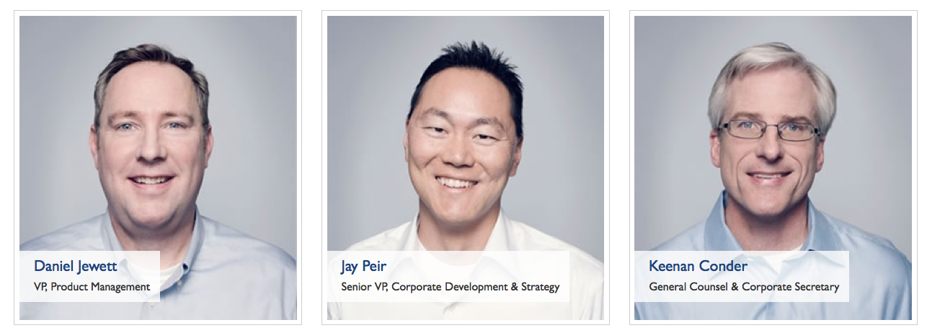
What is ?
Visualization and business analytics software with a strong focus on relational data
Idea originally developed at Stanford University
Now a publically traded company based in Seattle, WA with 2400 employees, $412 million in revenue (2014)
Image credit: www.tableau.com/about/leadership

Slide 10
Main Window: New Workbook

Slide 11
Main Window: with Data and Views

Slide 12
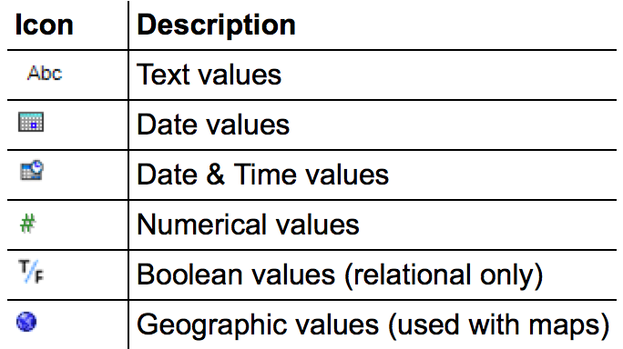
Data Types
All data fields are assigned one of the following types:
Occasionally the auto-detected type is wrong; this can be manually overridden using the menu

Slide 13
Main Window: with Data and Views

Slide 14
Data Roles: Dimensions
In general, any field containing qualitative or categorical information is treated as a dimension (e.g. text, dates)
In relational data, dimensions are the independent variables
Data can be aggregated using the values of a dimension
When added as rows/columns, dimensions produce headers

Slide 15
Data Roles: Measures
In general, any field containing quantitative information is treated as a measure (e.g. numerical data, etc.)
In relational data, measures are the dependent variables
The values of a measure are a function of one or more dimensions
When added as rows/columns, measures produce axes

Slide 16
Data Roles: Dimensions vs. Measures
measure
dimension
Which is which?
total number of students in each house
Which is which?
total number of students in each house
Which is which?
total number of students in each house

Slide 17
Main Window: with Data and Views

Slide 18
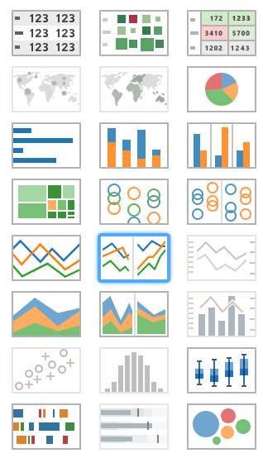
21 Available Views
Tables
Maps
Pie charts
Bar charts
Treemaps
Circle views
Line charts
Area charts
Combination charts
Scatterplots
Histograms
Box-and-whisker plots
Gantt
Bullet plots
Packed circles
Tables
Maps
Pie charts
Bar charts
Treemaps
Circle views
Line charts
Area charts
Combination charts
Scatterplots
Histograms
Box-and-whisker plots
Gantt
Bullet plots
Packed circles

Slide 19
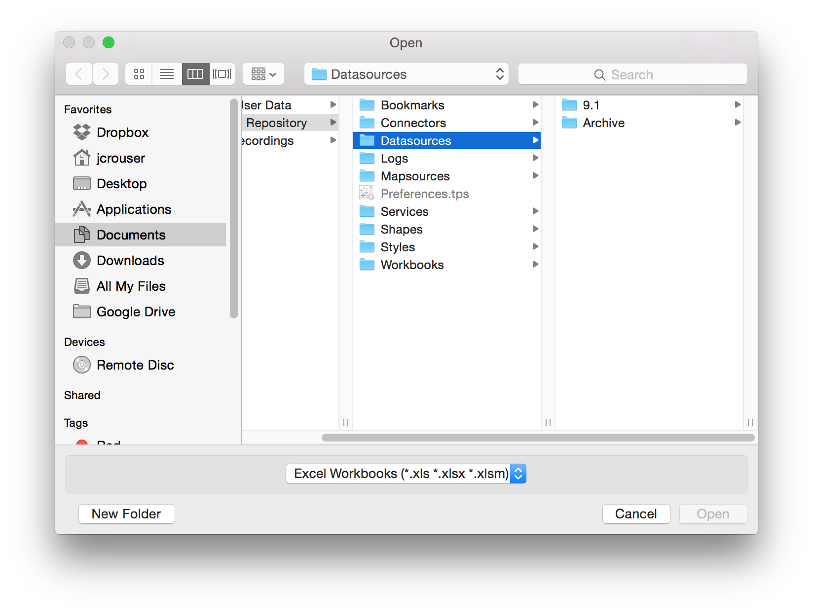
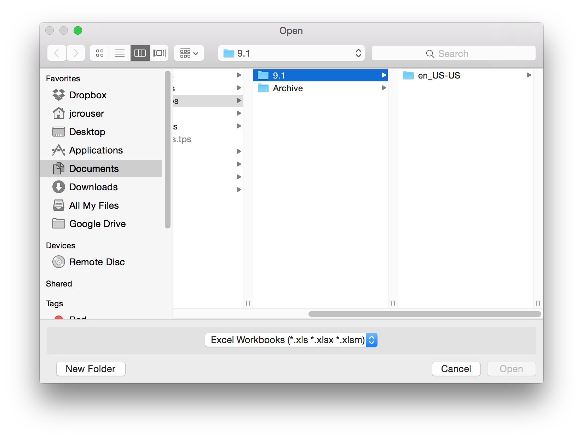
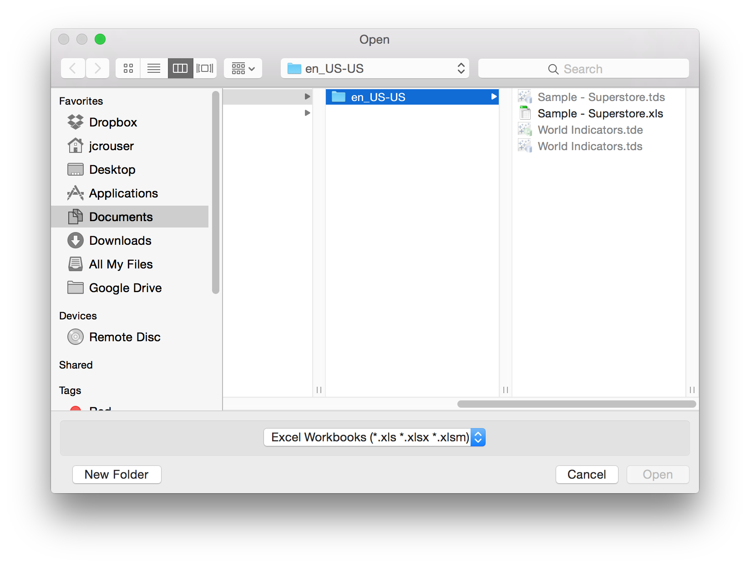
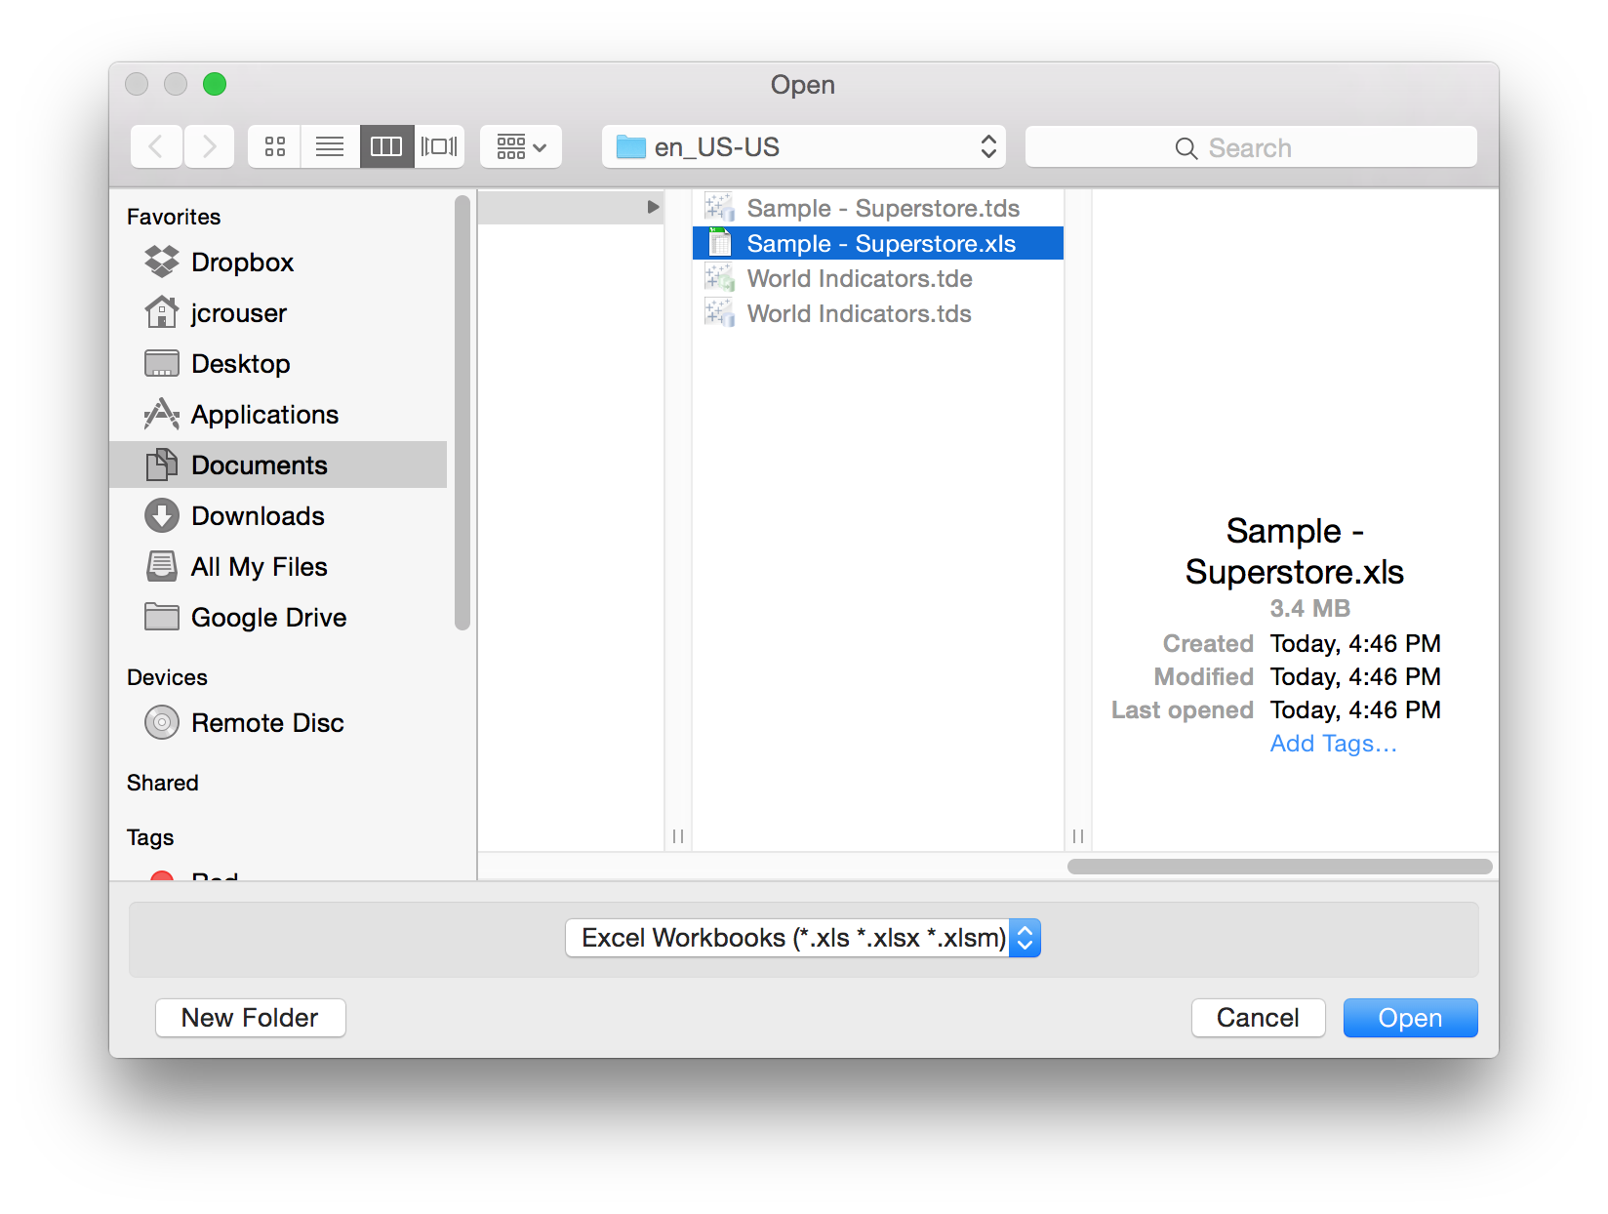
Lab pt. 1: Getting Started

Slide 20
Connecting to a Data File

Slide 21
Connecting to a Data File

Slide 22
Creating Views

Slide 23
Drag a dimension to “Columns”

Slide 24
Drag a dimension to “Rows”

Slide 25
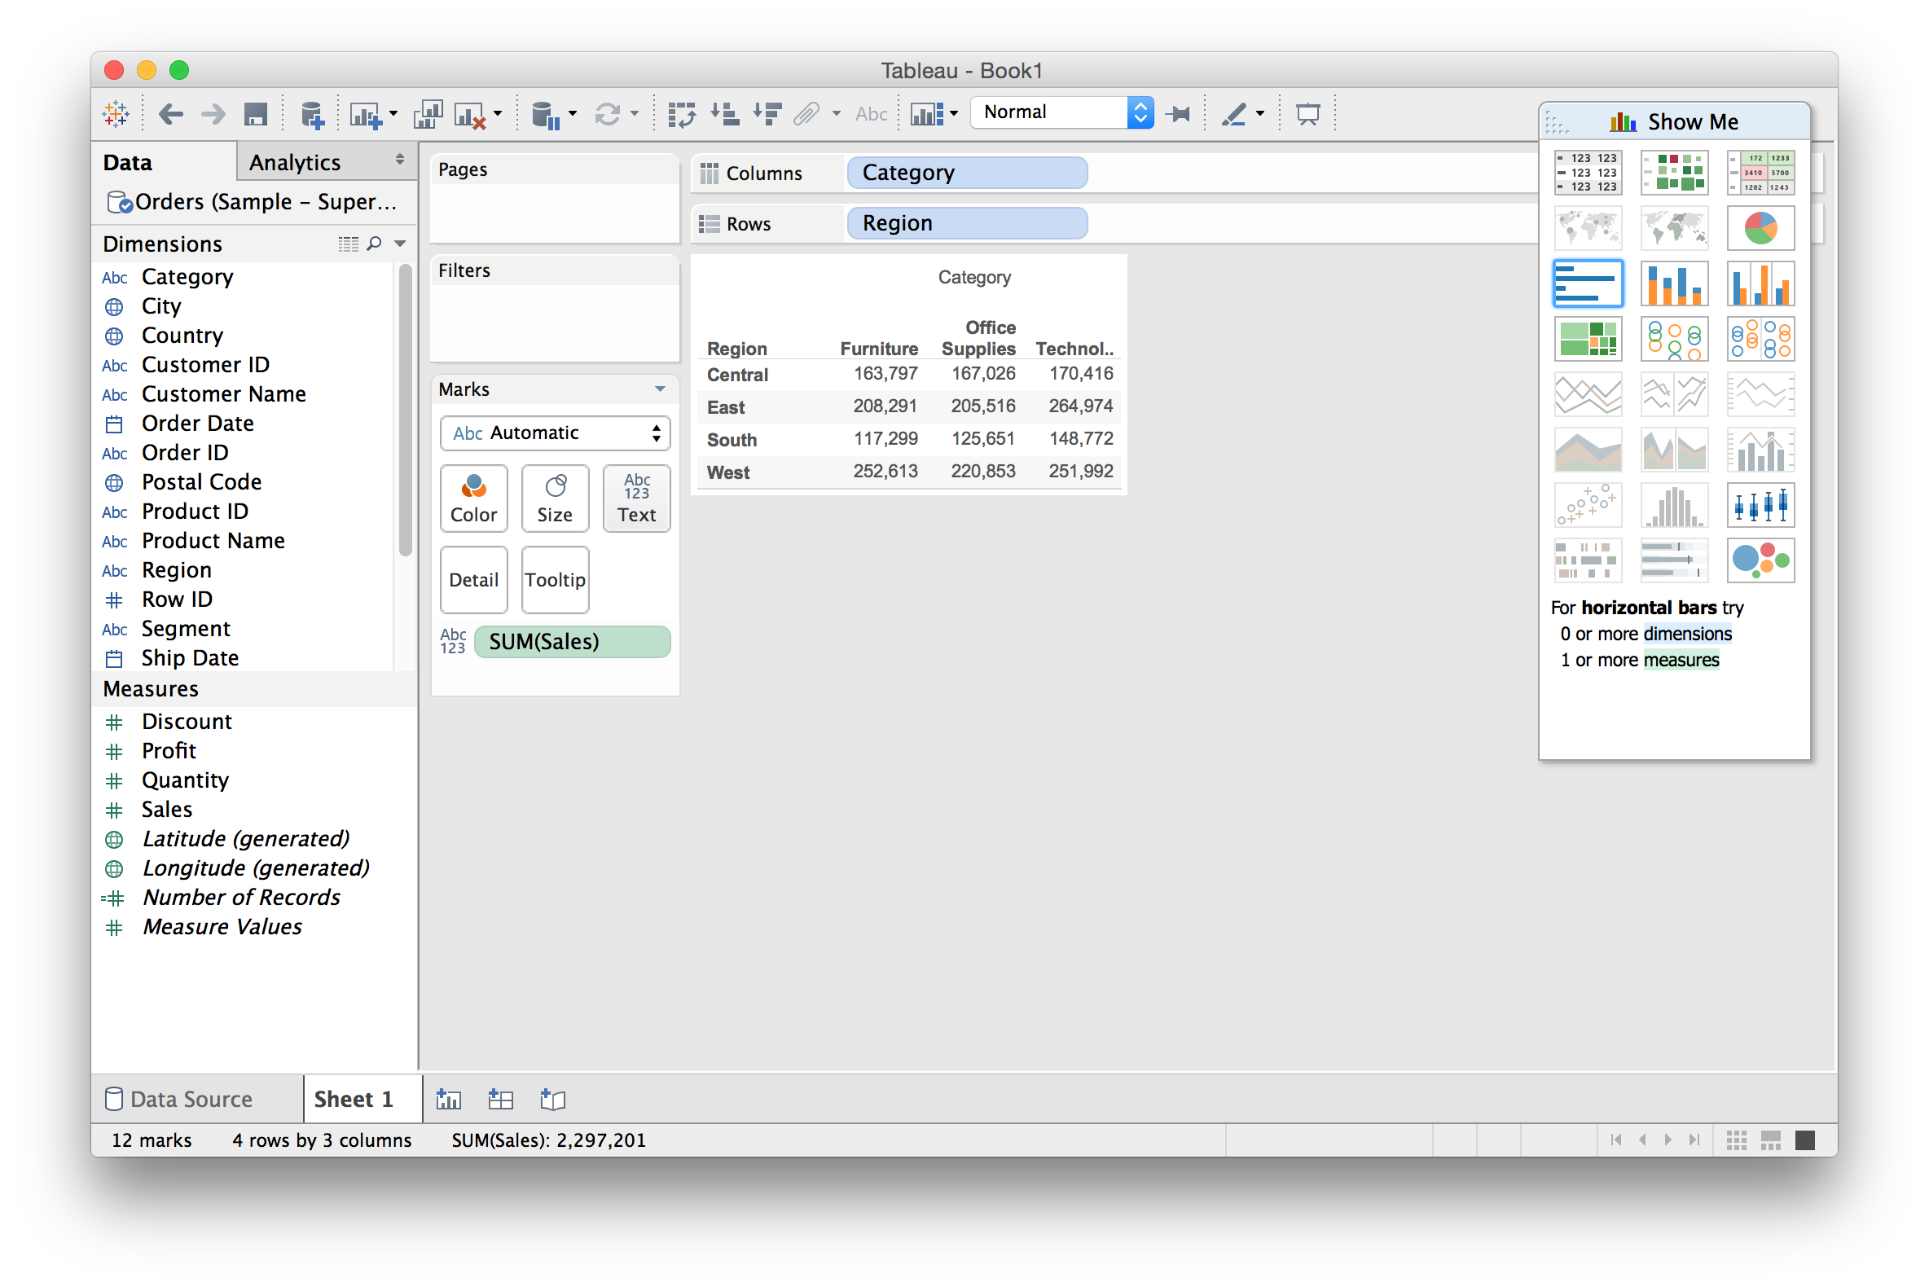
Drag a measure onto “Text”

Slide 26
Further refine by subdividing

Slide 27
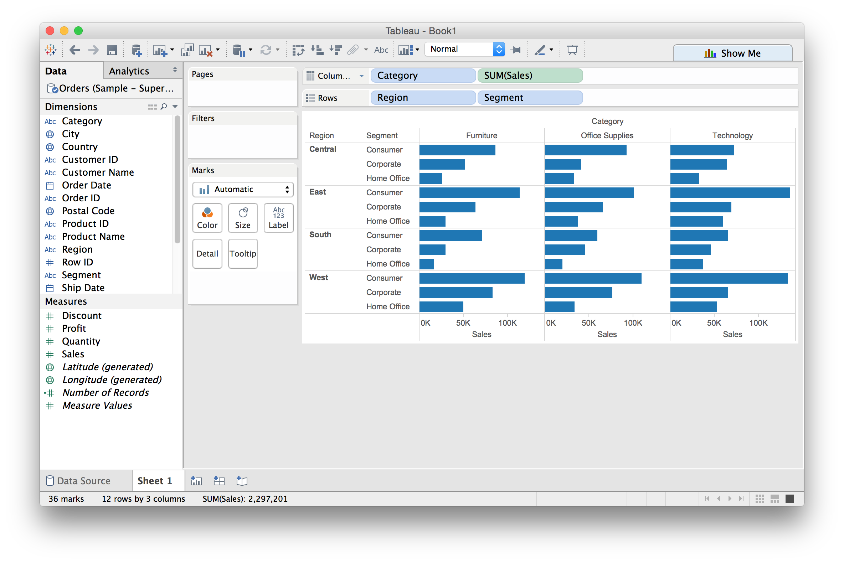
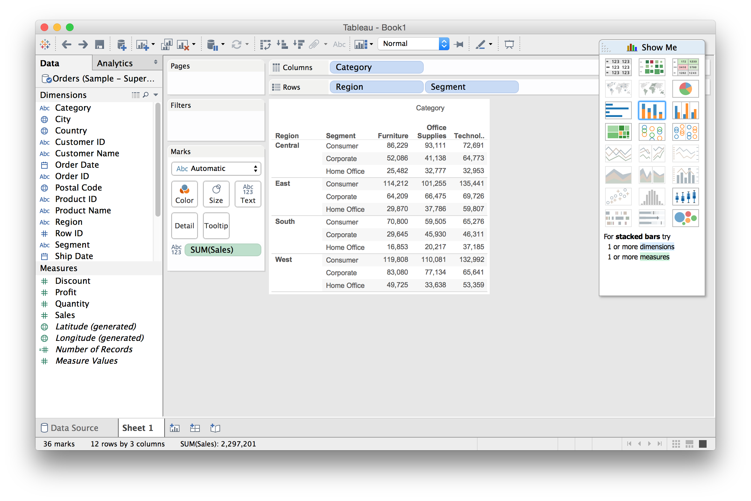
From Text Table to Bar Chart

Slide 28
Dual encoding using color

Slide 29
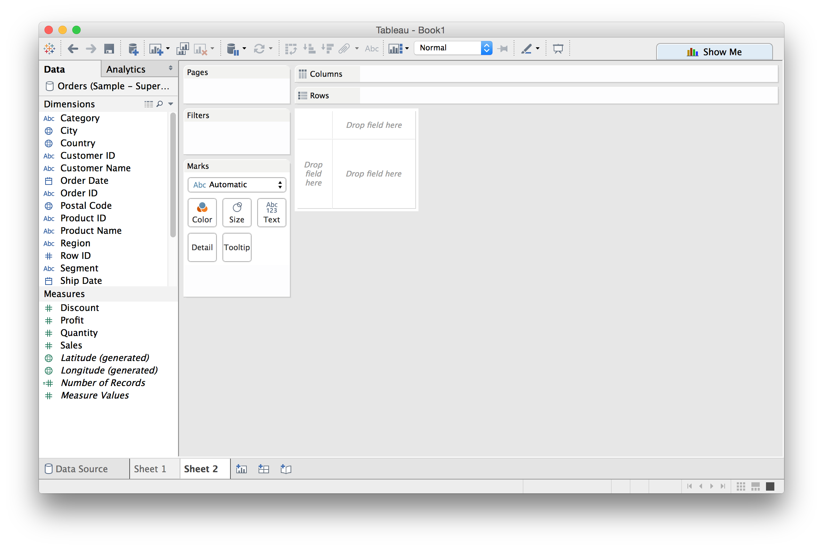
Creating a new sheet

Slide 30
Using “Show Me”: a VIS recommender

Slide 31
Using “Show Me”: a VIS recommender

Slide 32
Using “Show Me”: a VIS recommender

Slide 33
Building Stories from Multiple Views

Slide 34
Building Stories from Multiple Views

Slide 35
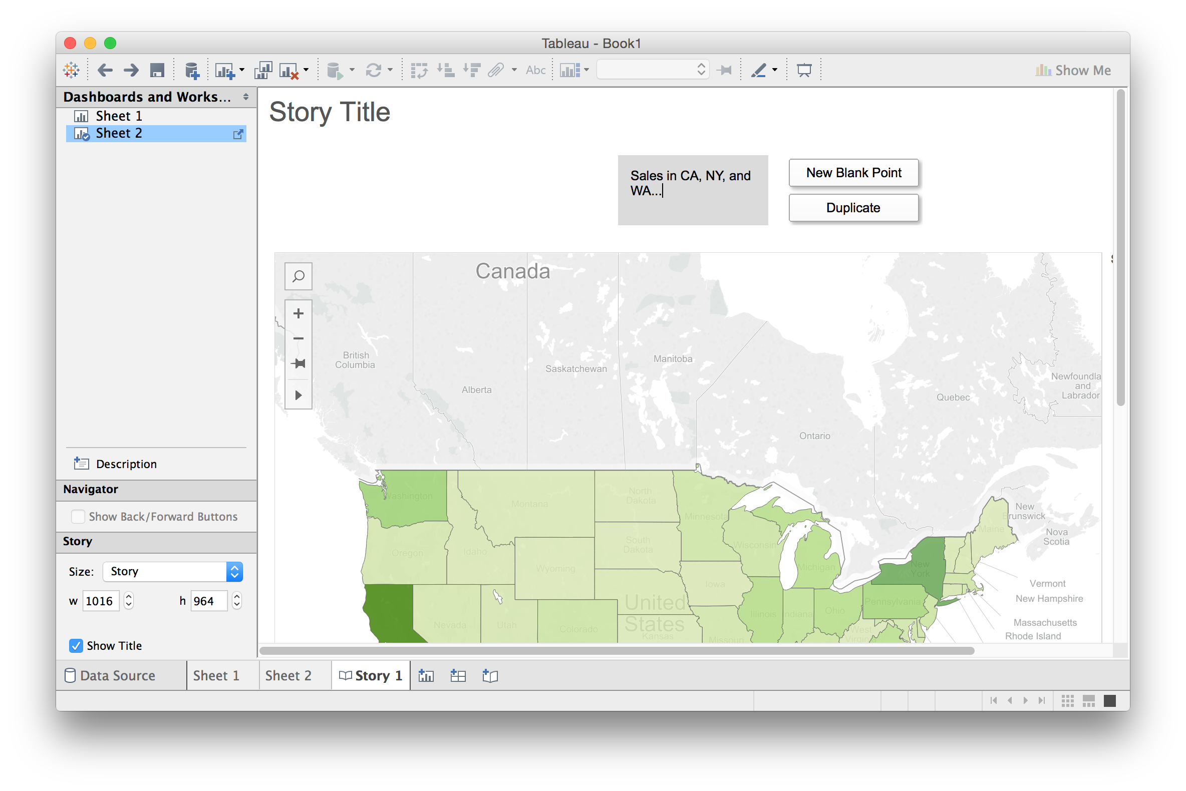
Building Stories from Multiple Views

Slide 36
Building Stories from Multiple Views

Slide 37
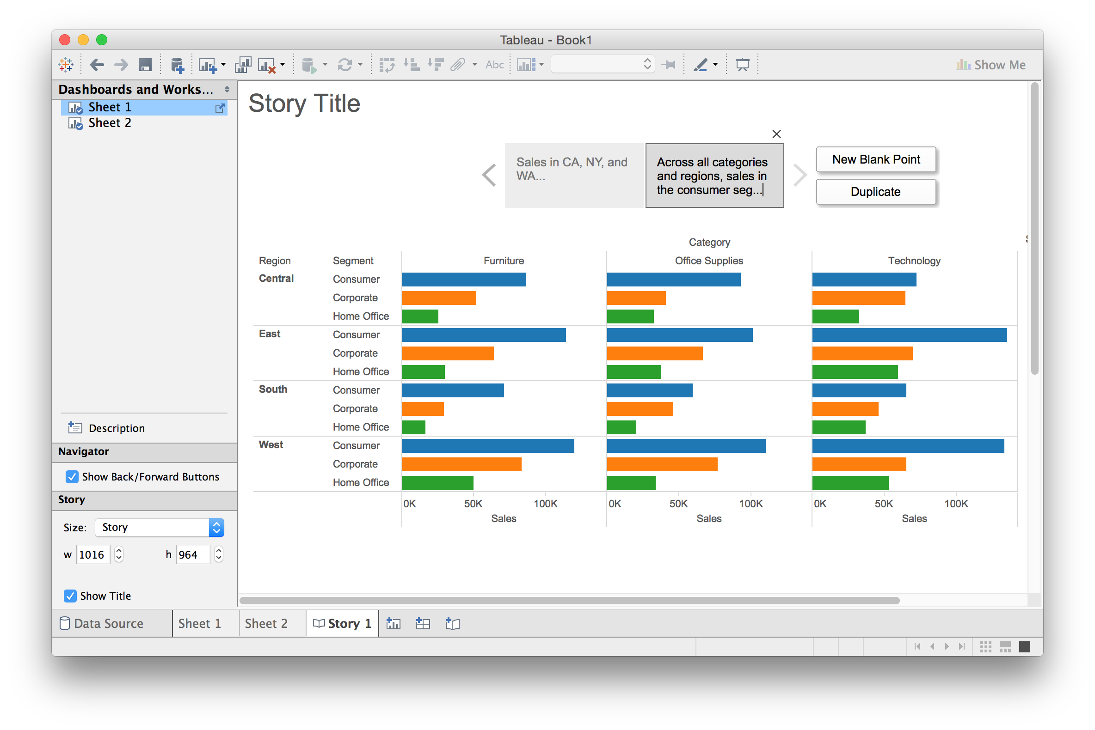
Building Stories from Multiple Views

Slide 38
Questions?

Slide 39
Lab pt. 2: Exploring Other Datasets

Slide 40
Lab pt. 2: Exploring Other Datasets
Olympic Athletes: goo.gl/1aUnJW
World Bank Indicators: goo.gl/0QdN9U
Airplane Bird Strikes: goo.gl/lFl5ld
…and a whole bunch more: goo.gl/kcbqfc

Slide 41
Discussion
What are some of Tableau’s strengths? Weaknesses?
Was there anything you couldn’t figure out?

Slide 42
Coming Up
Next class: Visualization Fundamentals pt. 1
Assignment 1 will be posted next week, and will be due the following Wednesday (Feb. 10th)

