Slide 1
Analyzing the Sound Pressure of Airfoil Self-Generated Noise
Group L: Ning Zhu, Lu Xia, Maria Xu

Slide 2
Background and Motivation

Slide 3
What is Airfoil Self Noise?
Notes:
Tho noise generated by an aircraft is an efficiency and environmental issue for the aerospace industry. A component of the total airframe noise is the self-noise of the airfoil, Airfoil self noise is generated by the interaction between an airfoil shape and the turbulent flow that it is placed in. For decades, researchers have been working on developing an aeroacoustic model to analyze and predict the airfoil self noise in order to find a way to reduce it. Our project focuses on the in sample analysis of airfoil noise.

Slide 4
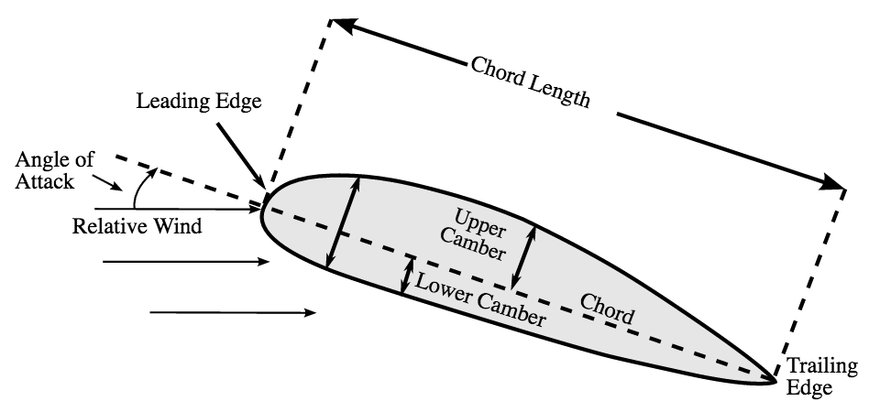
Image: https://en.wikipedia.org/wiki/File:Airfoil.svg
Notes:
An airfoil refers to the shape of a wing, as shown here.
Terminology, log scale
AOA: The angle between the reference line and the coming flow
CL: The length of the imaginary straight line connecting the leading edge and trailing edge of the airfoil
FSV: The center velocity of the fluid that the airfoil is moving in inside the wind tunnel
SSDT: The displacement of the streamline at the upper surface. A streamline can be just thought as a path of the moving flow.

Slide 5
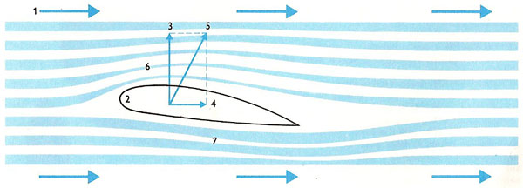
Image: http://www.daviddarling.info/images/airfoil_diagram.jpg

Slide 6
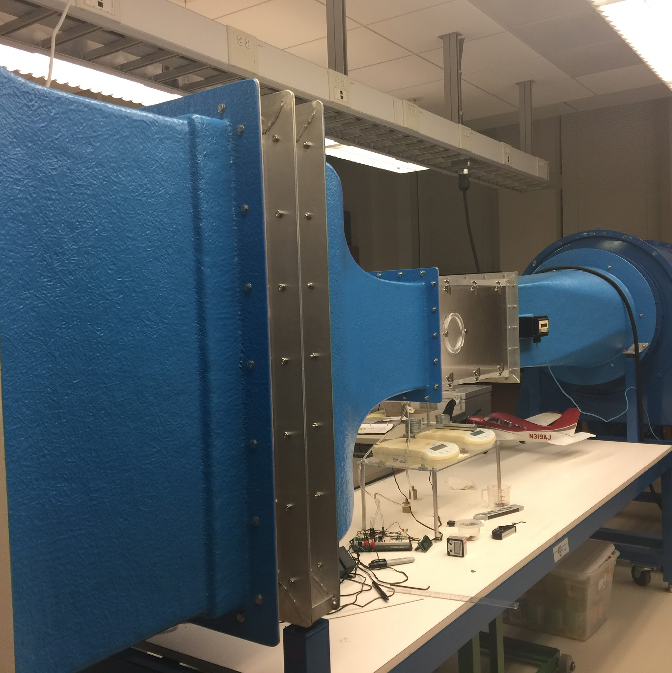
Where did we get the data?
Notes:
The dataset we are going to use is obtained from a series of aerodynamic and acoustic tests conducted in a wind tunnel.
A wind tunnel is a tool used in aerodynamic research to study the effects of air moving past solid objects. Here is a picture of the wind tunnel located in the basement of Ford Hall.
Our data includes measurements of the noise generated by airfoils of different sizes, at various wind tunnel speeds and different angles of attack. The span of the airfoil and the observer position were the same in all of the experiments.

Slide 7
Dataset
Explanatory Variables:
1. Frequency, in Hertzs.
2. Angle of Attack, in degrees.
3. Chord length, in meters.
4. Free-stream velocity, in meters per second.
5. Suction side displacement thickness, in meters.
Response variable:
6. Sound pressure level, in decibels.
Size: 1503 entries
Origin: NASA, July 1989
Notes:
Reasons to use log-scale:
the logarithmic scale helps us to handle numbers on a wide scale much more easily
Human ear responds to the logarithmic change in level, which corresponds to the decibel scale

Slide 8
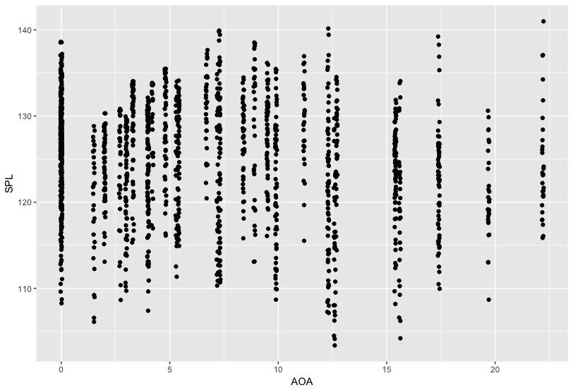
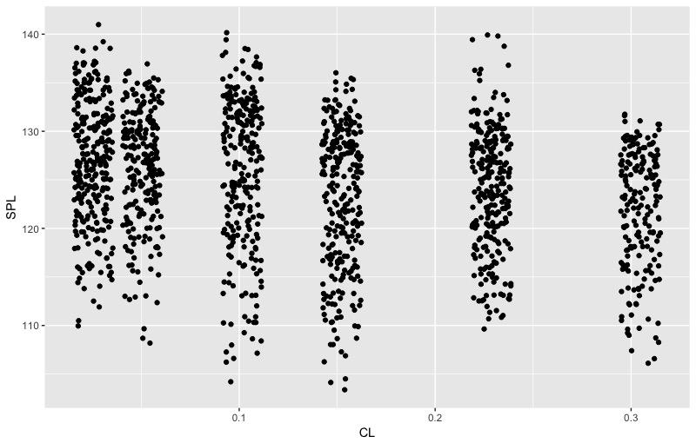
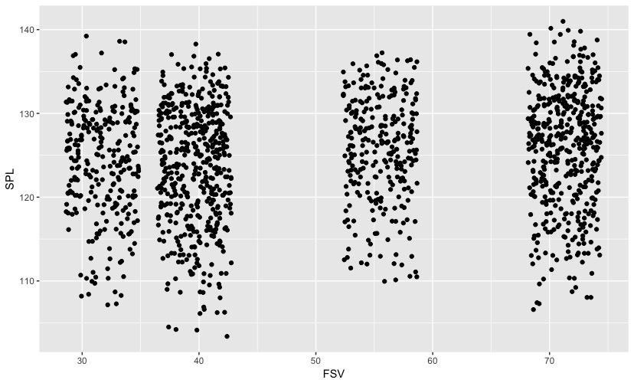
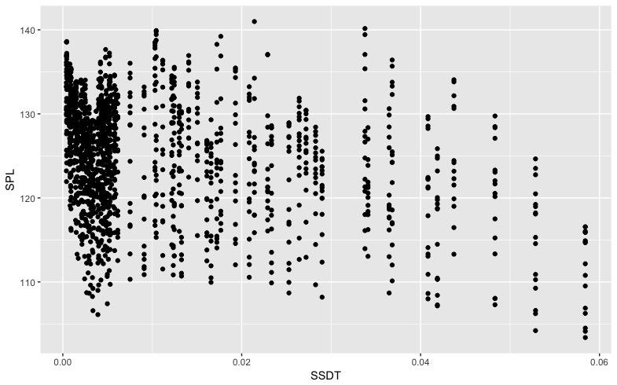
Dataset
Angle of Attack
Chord Length
Free-Stream Velocity
Suction-side suction displacement
Notes:
No trend
Experiment: controlled variables. So these plots are expected.
Except the frequency, which couldn’t be manually controlled.

Slide 9
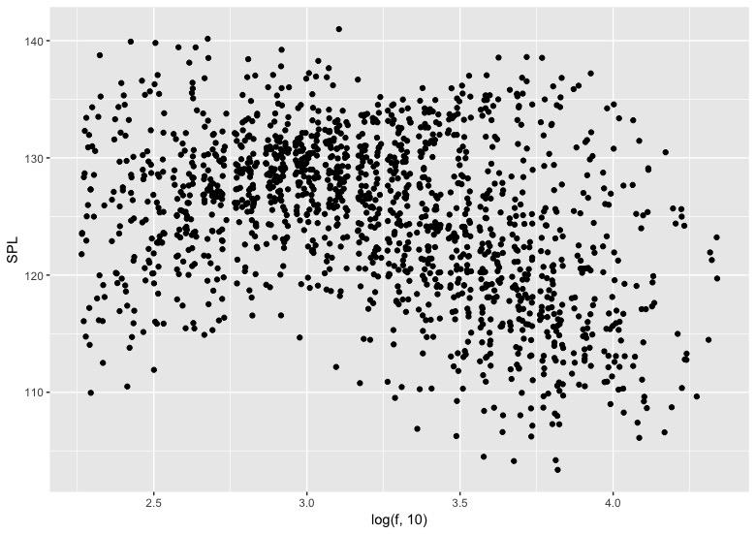
Notes:
Thus, we observe a unique plot for log(frequency) vs spl.
The range of frequencies was from 200 Hz to 20 kHz, which is very large.
In Engineering Acoustics, it is normal practice to display frequencies in log scale to better visualize the large frequency range.

Slide 10
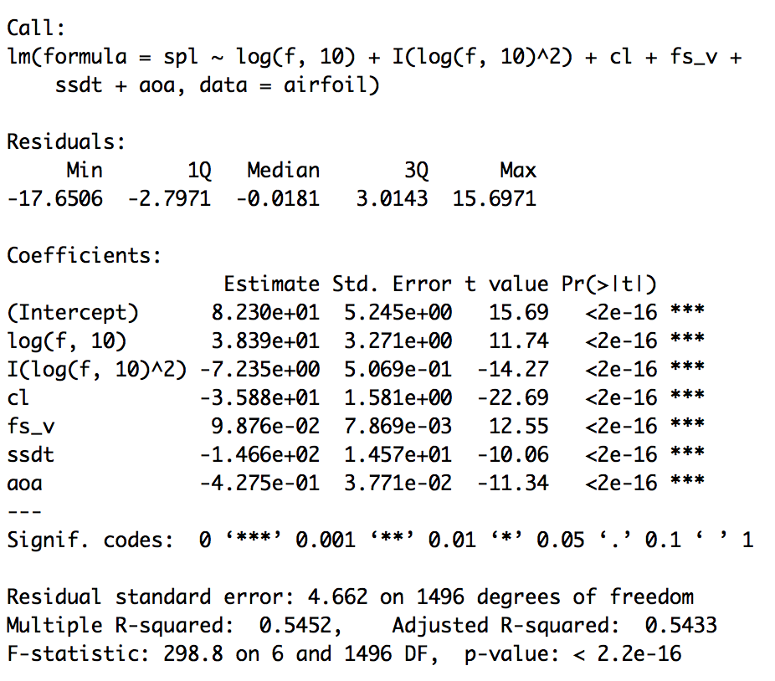
Model
Notes:
Normally, log scale for f
From the log f vs spl plot, shows quadratic relationship. Thus log(f, 10) + I (log(f, 10)^2)
P_value: all significant

Slide 11
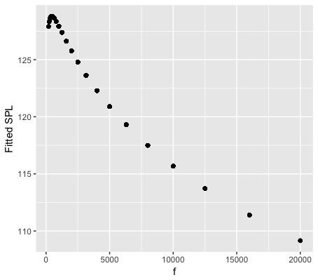
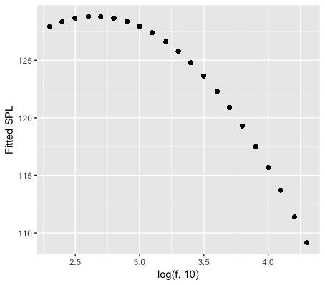
Model Interpretation
400
Notes:
400

Slide 12
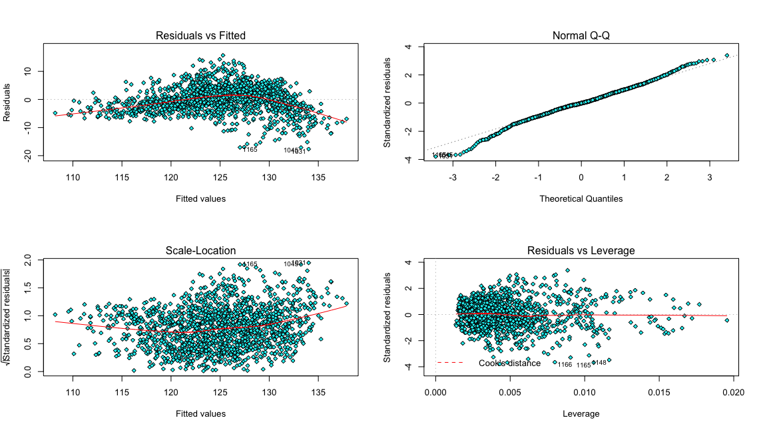
Inference Conditions
Notes:
From the four diagnostic plots of our linear model. We can tell from the residuals v.s fitted plot that the red line did not deviate significantly from the horizontal zero line, so we assumed that the reponse data are somewhat linear. Therefore the four conditions for linear regression inference were not ideally met but we are comfortable for now with in sample anaylsis but not with inference or prediction.

