Slide 1
Visualizing RNA-Seq Differential Expression Results with CummeRbund

Slide 2
RNA-Seq Pipeline
‘The Tuxedo Suite’
Software is all free and downloadable from the internet!
Run locally (on your computer) using a linux platform or
through the web based bioinformatics site Galaxy (https://main.g2.bx.psu.edu/)
Trapnell et al. (2012) Nature Protocols 7 (3) 562-578.
Notes:
This seems relatively straight-forward, however, remembering that I have 15 different treatment groups-plus the fact that we want to look at differentially expressed genes in both Bm and wBm! A lot of bioinformatics!

Slide 3
Files you will need to analyze RNA-seq data using Tuxedo Suite
RNA-Seq files-FASTQ (Sanger) format
  FASTQ is a form of FASTA (sequence) file which includes quality scores
Your genome file (FASTA file)
Genome annotation file (either GFF3 or GTF file)

Slide 4

R Programming Language
R is a programming language traditionally used for statistical and graphical analysis
While all other Tuxedo Suite programs are run in Linux, the final ‘visualization’ step-CummeRbund-is run in R
Download R
(http://www.r-project.org/)-you can use this to run CummeRbund, however it is a bit more primitive than Rstudio (I find RStudio is easier to use)
Download RStudio-
(http://www.rstudio.com/ide/download/desktop)

Slide 5
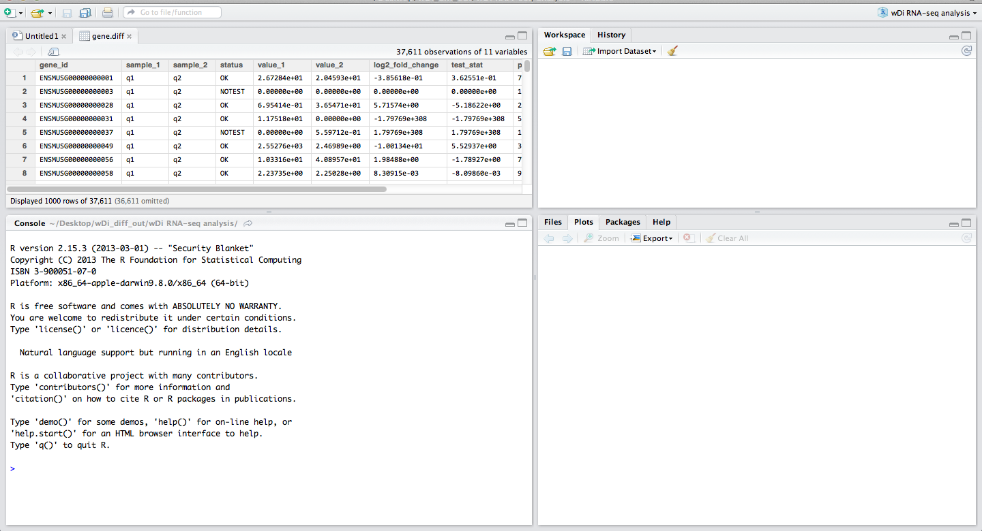
RStudio
This is your workspace-where you will type all commands!

Slide 6
RStudio
This is where any data tables you create will appear!

Slide 7
RStudio
This is where any ‘objects’ or gene sets you create will appear!

Slide 8
RStudio
This is where any plots you make will appear!

Slide 9
RStudio
Plots can be exported as an image file (png, jpeg, tiff, bmp, svg or evs) or as a pdf

Slide 10
R basics
In R when you type a command and add your open parenthesis ( R automatically closes it for you
  You type ( and () appears
Get working directory
  getwd()
Set working directory
  setwd()
This is pretty much all the R language you need to know to run CummeRbund-the rest of the language is specific to CummeRbund

Slide 11
CummeRbund
Download CummeRbund-
(http://compbio.mit.edu/cummeRbund)
-on the right hand side of the page (under Releases) select the version you need (Mac OS or Windows).
This will download a compressed file into your downloads.
Unzip this file.

Slide 12
Download Cuffdiff Files from Galaxy
Create a new folder on your Desktop called diff_out
From Galaxy history: Download all 11 Cuffdiff output files.
Once they are all downloaded, move all 11 files from your downloads folder (or wherever your downloads go) into the newly created diff_out folder on your Desktop.

Slide 13
Re-Naming Cuffdiff Output Files
All files must be re-named in order for CummeRbund to recognize them.
All Galaxy downloaded file names will begin with something like: Galaxy56[Cuffdiff_on_data_45,_data_41,_and_data_3
this should be fairly similar for all 11 files and we can ignore-what we care about is at the end of the Galaxy file name, i.e. transcript_FPKM_tracking. This is the part that tells you what the output is and how it must be re-named.

Slide 14
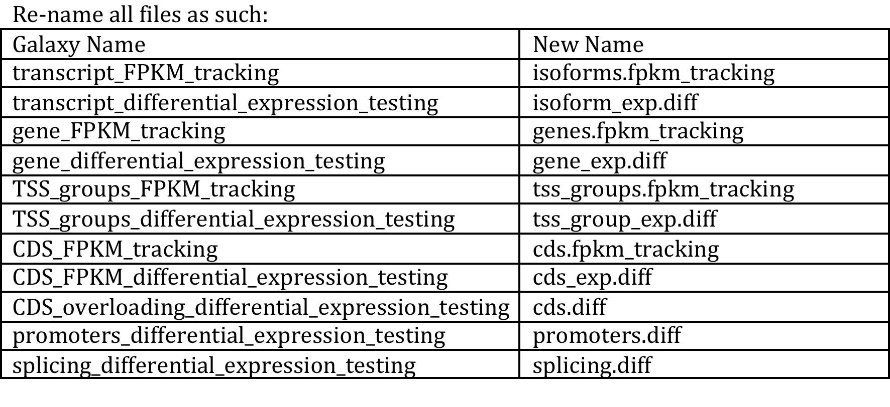
Renaming Galaxy Cuffdiff Files
Once this is complete you can start analyzing data with CummeRbund!

Slide 15
Running R
In the remaining slides text shown in BLACK are my explanations to you
Text shown in BLUE are the commands you should input into RStudio
Text shown in RED are lines of code output from RStudio if your command worked correctly

Slide 16
Visualize the Data with CummeRbund
Open RStudio
R version 2.15.3 (2013-03-01) -- "Security Blanket"
Copyright (C) 2013 The R Foundation for Statistical Computing
ISBN 3-900051-07-0
Platform: x86_64-apple-darwin9.8.0/x86_64 (64-bit)
R is free software and comes with ABSOLUTELY NO WARRANTY.
You are welcome to redistribute it under certain conditions.
Type 'license()' or 'licence()' for distribution details.
Natural language support but running in an English locale
R is a collaborative project with many contributors.
Type 'contributors()' for more information and
'citation()' on how to cite R or R packages in publications.
Type 'demo()' for some demos, 'help()' for on-line help, or
'help.start()' for an HTML browser interface to help.
Type 'q()' to quit R.

Slide 17
Install CummeRbund
To install the CummeRbund package use the following commands:
> source('http://www.bioconductor.org/biocLite.R')
> biocLite('cummeRbund')

Slide 18
Setting the Working Directory
Get working directory
>getwd()
This will tell you what your current working directory is.
Set working directory-I usually set mine as my computer-note that this could be different on your computer but should be one level up from the Desktop
>setwd(“/Users/slatko”)
I then usually check my working directory again-just to make sure it is set where I want it to be.
>getwd()

Slide 19
Load CummeRbund into R
To load CummeRbund into R use the following command:
>library(cummeRbund)
Loading required package: BiocGenerics
Attaching package: ‘BiocGenerics’
The following object(s) are masked from ‘package:stats’:
xtabs
The following object(s) are masked from ‘package:base’:
anyDuplicated, cbind, colnames, duplicated, eval, Filter, Find, get,
intersect, lapply, Map, mapply, mget, order, paste, pmax, pmax.int, pmin,
pmin.int, Position, rbind, Reduce, rep.int, rownames, sapply, setdiff, table,
tapply, union, unique
Loading required package: RSQLite
Loading required package: DBI
Loading required package: ggplot2
Loading required package: reshape2
Loading required package: fastcluster
Attaching package: ‘fastcluster’
The following object(s) are masked from ‘package:stats’:
hclust
Loading required package: rtracklayer
Loading required package: GenomicRanges
Loading required package: IRanges
Loading required package: Gviz
Loading required package: grid

Slide 20
Creating a CummeRbund Database
Now you must create a database out of your 11 cuffdiff output files.
> cuff_data<-readCufflinks('~/Desktop/diff_out’)
Again-this will take a minute or two to run a number of lines of script (see next page) while creating a database file.
Once this is complete you will notice your diff_out folder on your desktop now contains a file called cuff_data.db
  This is your CummeRbund database!

Slide 21
Creating database ~/Desktop/mouse_diff_out/cuffData.db
Reading ~/Desktop/mouse_diff_out/genes.fpkm_tracking
Checking samples table...
Populating samples table...
Writing genes table
Reshaping geneData table
Recasting
Writing geneData table
Reading ~/Desktop/mouse_diff_out/gene_exp.diff
Writing geneExpDiffData table
Reading ~/Desktop/mouse_diff_out/promoters.diff
Writing promoterDiffData table
No records found in ~/Desktop/mouse_diff_out/promoters.diff
Reading ~/Desktop/mouse_diff_out/isoforms.fpkm_tracking
Checking samples table...
OK!
Writing isoforms table
Reshaping isoformData table
Recasting
Writing isoformData table
Reading ~/Desktop/mouse_diff_out/isoform_exp.diff
Writing isoformExpDiffData table
Reading ~/Desktop/mouse_diff_out/tss_groups.fpkm_tracking
Checking samples table...
OK!
Writing TSS table
No records found in ~/Desktop/mouse_diff_out/tss_groups.fpkm_tracking
TSS FPKM tracking file was empty.
Reading ~/Desktop/mouse_diff_out/tss_group_exp.diff
No records found in ~/Desktop/mouse_diff_out/tss_group_exp.diff
Reading ~/Desktop/mouse_diff_out/splicing.diff
No records found in ~/Desktop/mouse_diff_out/splicing.diff
Reading ~/Desktop/mouse_diff_out/cds.fpkm_tracking
Checking samples table...
OK!
Writing CDS table
No records found in ~/Desktop/mouse_diff_out/cds.fpkm_tracking
CDS FPKM tracking file was empty.
Reading ~/Desktop/mouse_diff_out/cds_exp.diff
No records found in ~/Desktop/mouse_diff_out/cds_exp.diff
Reading ~/Desktop/mouse_diff_out/cds.diff
No records found in ~/Desktop/mouse_diff_out/cds.diff
Indexing Tables...

Slide 22
Now it is time to visualize your results!

Slide 23
Density Plot
The density plot will show you the distribution of your RNA-seq read counts (fpkm)
> csDensity(genes(cuff_data))
This will plot data for genes. You can also do this with other data from Cuffdiff, e.g., isoforms.

Slide 24
Volcano Plot
A volcano plot is a scatter plot that also identifies differentially expressed genes (by color) between samples
>v<-csVolcanoMatrix(genes(cuff_data))
This line creates a command (v)-to execute the command you must type the following line
>v

Slide 25
Volcano Matrix

Slide 26
Scatter Plot
Shows differences in gene expression between two samples
  If two samples were identical all dots (genes) would fall on the mid-line
>csScatter(genes(cuff_data))

Slide 27
Looking a Specific Genes of Interest
3 Genes
  F9
  Rdh7
  Gapdh

Slide 28
Getting Gene Info
>myGeneId<-"F9"
> myGene<-getGene(cuff_data,myGeneId)
> myGene
CuffGene instance for gene ENSMUSG00000031138
Short name: F9
Slots:
annotation
features
fpkm
repFpkm
diff
count
isoforms CuffFeature instance of size 1
TSS CuffFeature instance of size 0
CDS CuffFeature instance of size 0
This tells you how many isoforms of this gene there are.
Here you could also find out if your gene had more than one transcriptional start site (TSS)
How many isoforms do Rdh7 and Gapdh have??
Notes:
there should be 3 isoforms of Rdh7 and 6 isoforms of Gapdh

Slide 29
Looking at Groups of Genes
>myGeneIds<- c("F9","Rdh7", "Gapdh")
> myGenes <- getGenes(cuff_data,myGeneIds)
Getting gene information:
FPKM
Differential Expression Data
Annotation Data
Replicate FPKMs
Counts
Getting isoforms information:
FPKM
Differential Expression Data
Annotation Data
Replicate FPKMs
Counts
Getting CDS information:
FPKM
Differential Expression Data
Annotation Data
Replicate FPKMs
Counts
Getting TSS information:
FPKM
Differential Expression Data
Annotation Data
Replicate FPKMs
Counts
Getting promoter information:
distData
Getting splicing information:
distData
Getting relCDS information:
distData

Slide 30
Plot Expression of ‘Your Genes’
>gb<-expressionBarplot(myGenes,showErrorbars=FALSE)
Scale for 'colour' is already present. Adding another scale for 'colour', which will replace the existing scale.
> gb
* The argument showErrobars=FALSE is necessary because of a lack of replicates. The default is showErrorbars=TRUE, but because there are no replicates there is no error to show!

Slide 31
Plot Expression of ‘Your Genes’-Heatmap
>h<-csHeatmap(myGenes)
> h

Slide 32
CummeRbund Conclusions
Relatively easy to use
Great way to visualize differential expression data from RNA-seq experiments
This is just the beginning-CummeRbund can do much more!
If interested, the complete CummeRbund manual can be found online
(http://compbio.mit.edu/cummeRbund/manual_2_0.html)

